Slide 1
Am I Entitled? How to manage access with Azure AD Entitlements
India Cloud Security Summit
Al Eardley • @al_eardley
28 August 2021

Slide 2
A One Day Virtual Event
Win exiting prizes!
Hands on sessions by experts and community leaders
Deep-dive into Microsoft’s Cloud Security Stack
Focus on
Microsoft 365
Dynamics 365
Microsoft Azure
Microsoft Power Platform
LENOVO TAB M10
ECHO DOT 3RD GEN

Slide 3
Eliminate Hunger
Youth Ubaal Foundation is a small organization actively working towards providing two-time healthy meals to the children residing in the slums of Delhi.
We have joined hands with Youth Ubaal to raise awareness about this beautiful cause.
Do Contribute!
Link on website: www.indiacloudsecuritysummit.com

Slide 4
Thanks to all the sponsors

Slide 5
Al Eardley
M365 Security & Compliance UG
https://m365sandc.tech/home
@M365SandCUG
Modern Work & Security Technical Architect
Microsoft Technology Centre, UK
https://www.microsoft.com/en-us/mtc
GreyHatBeard Podcast
https://www.greyhatbeard.com
@GreyHatBeard
London Power Platform UG
https://PowerPlatform.London/Home
@LondonPPUG

Slide 6
The problem

Slide 7
The new user’s dilemma
What Microsoft Teams should I have access to?
What SharePoint sites should I have access to?
Who do I ask for these permissions?
Who will need to approve these permissions?

Slide 8
Scenarios
New Starter
Assign same permissions as John
All permissions are permanently allocated
Join Project Team
Temporary assignment
External users need access
Change Job
Remove once set of permissions
Assign new permissions

Slide 9
Who knows?
Does everyone with permissions still need them?
Who knows who should have access?
How often should permissions be reviewed?

Slide 10
External Partners
Grant limited permissions
Who knows who needs permissions?

Slide 11
The solution

Slide 12
Entitlements
Create a catalog of resources
Create access packages with combinations of permissions
Publish them with polices defining approval processes

Slide 13
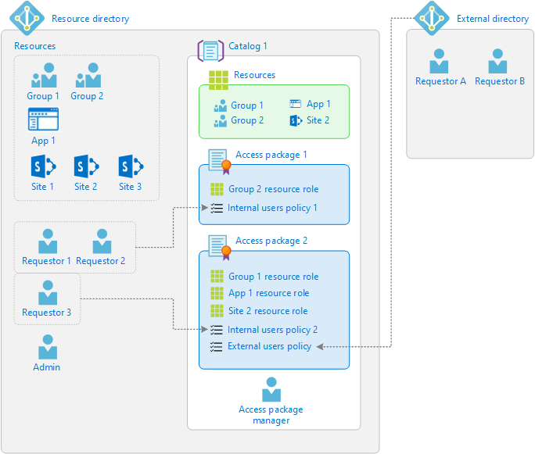
Building Blocks

Slide 14
As a User
Browse the available entitlements
Request those that I need
Once they are approved, I have access

Slide 15
Demo time
This Photo by Unknown Author is licensed under CC BY-SA

Slide 16
Demo
As an Admin
Create a Catalog
As a user
Browse Access Packages
Request Access Package
As a Manager
Approve Access Package
As a User
Get Access
As a Manager
Review Access
Create access packages

Slide 17
Create Catalog

Slide 18
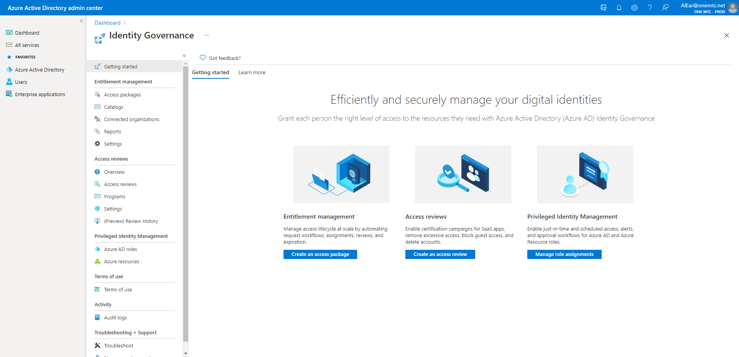
Create a Catalog – Step 1

Slide 19
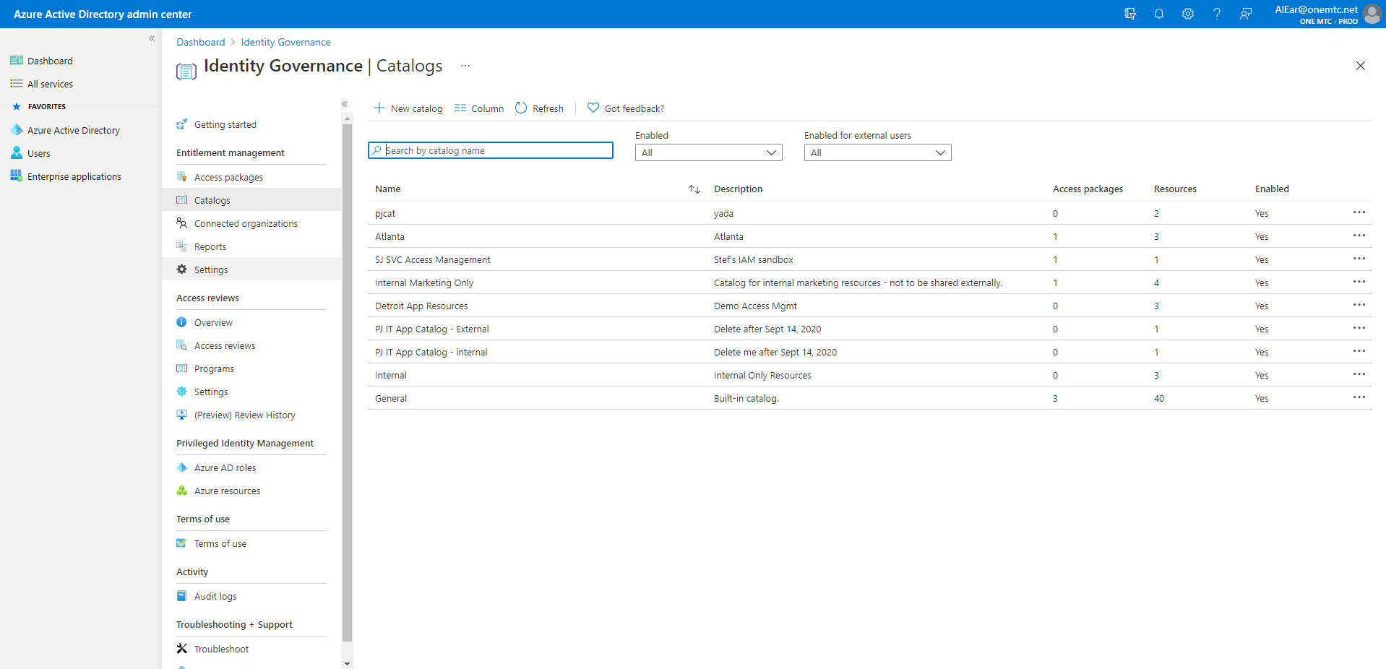
Create Catalog – Step 2

Slide 20
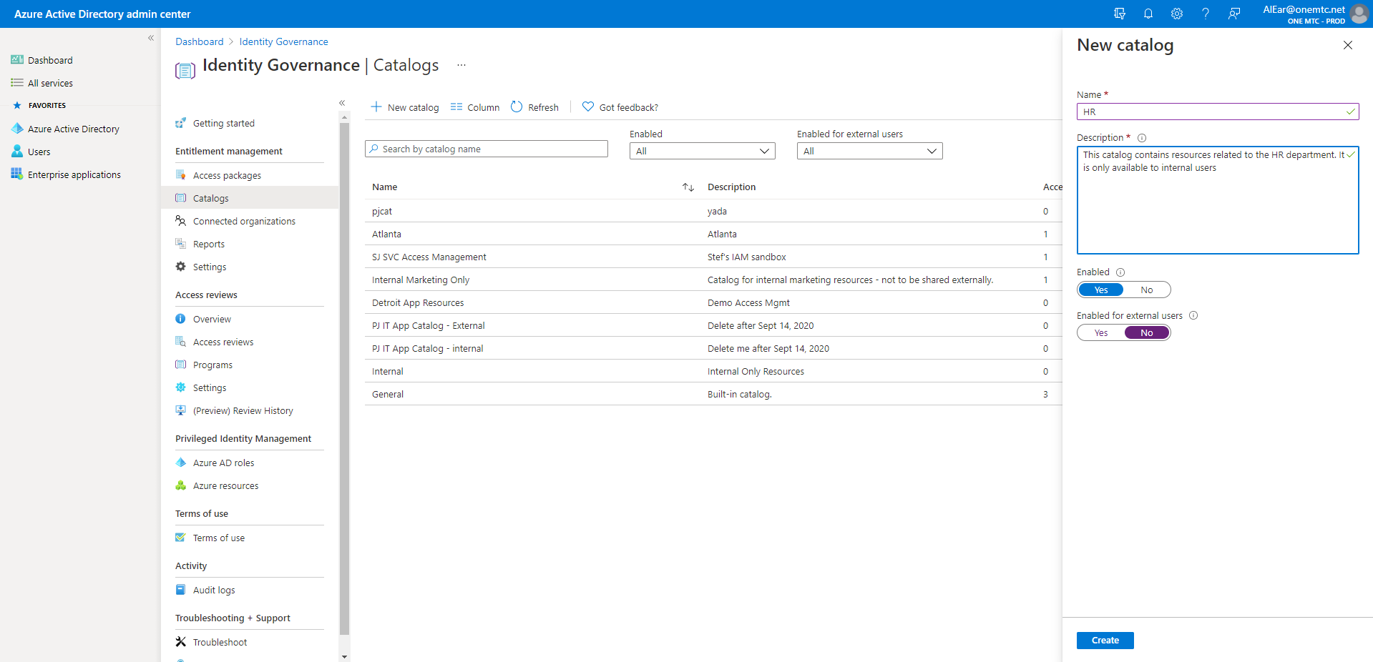
Create Catalog – Step 3

Slide 21
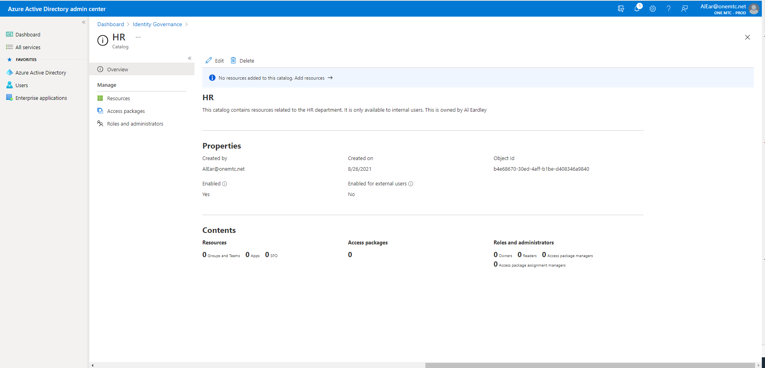
Create Catalog – Step 4

Slide 22
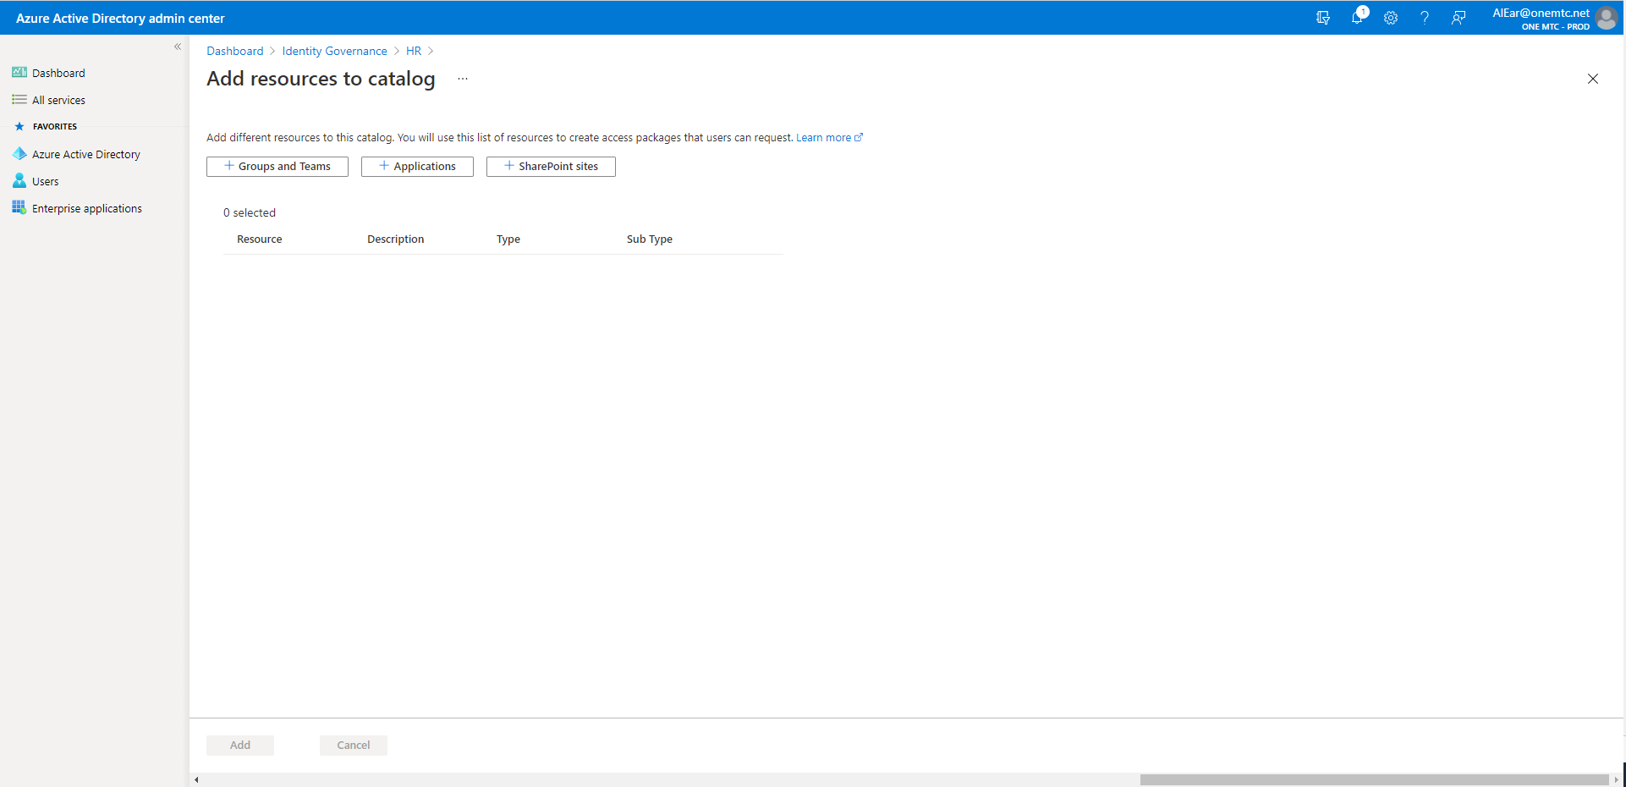
Create Catalog – Step 5

Slide 23
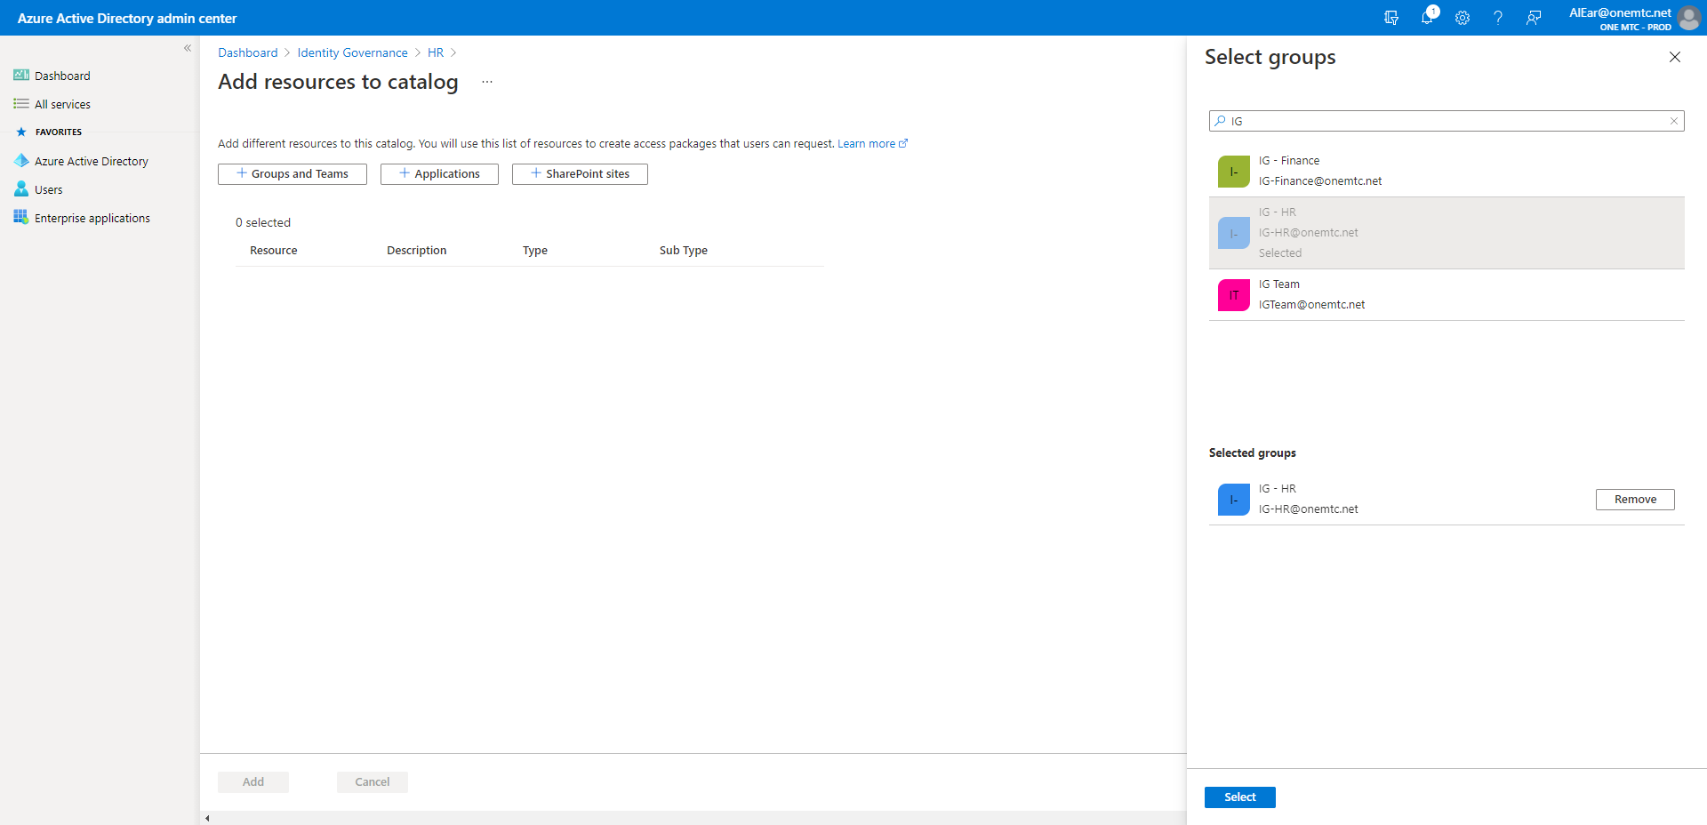
Create Catalog – Step 6

Slide 24
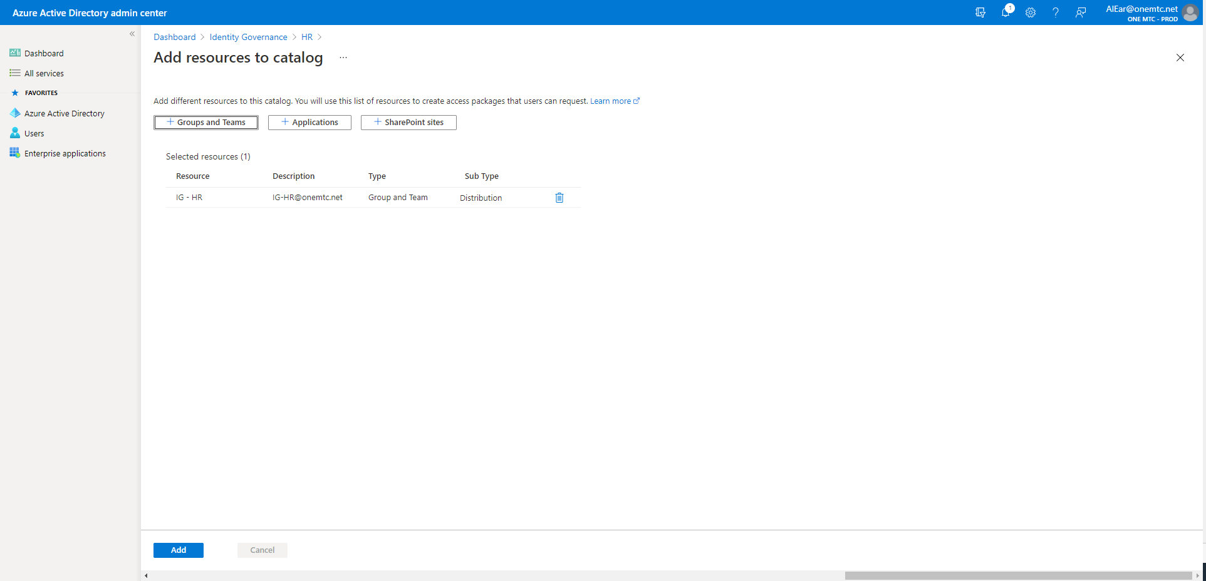
Create Catalog – Step 7

Slide 25
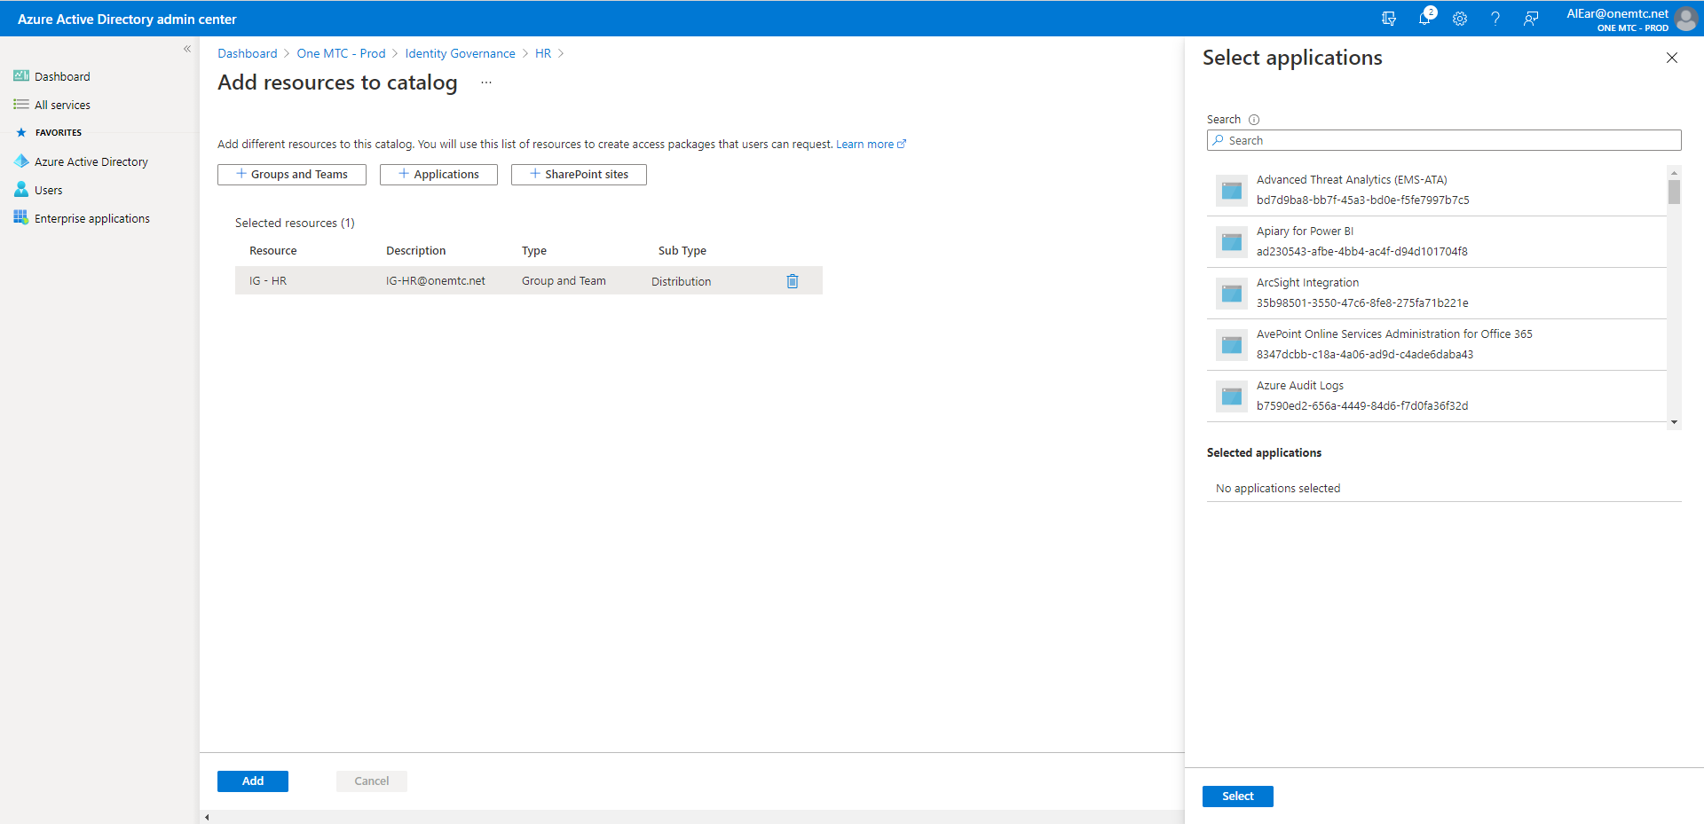
Create Catalog – Step 8

Slide 26
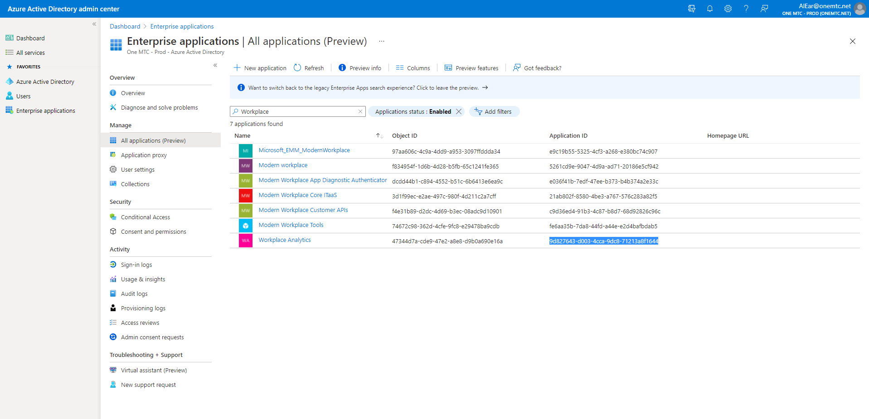
Create Catalog – Step 9

Slide 27
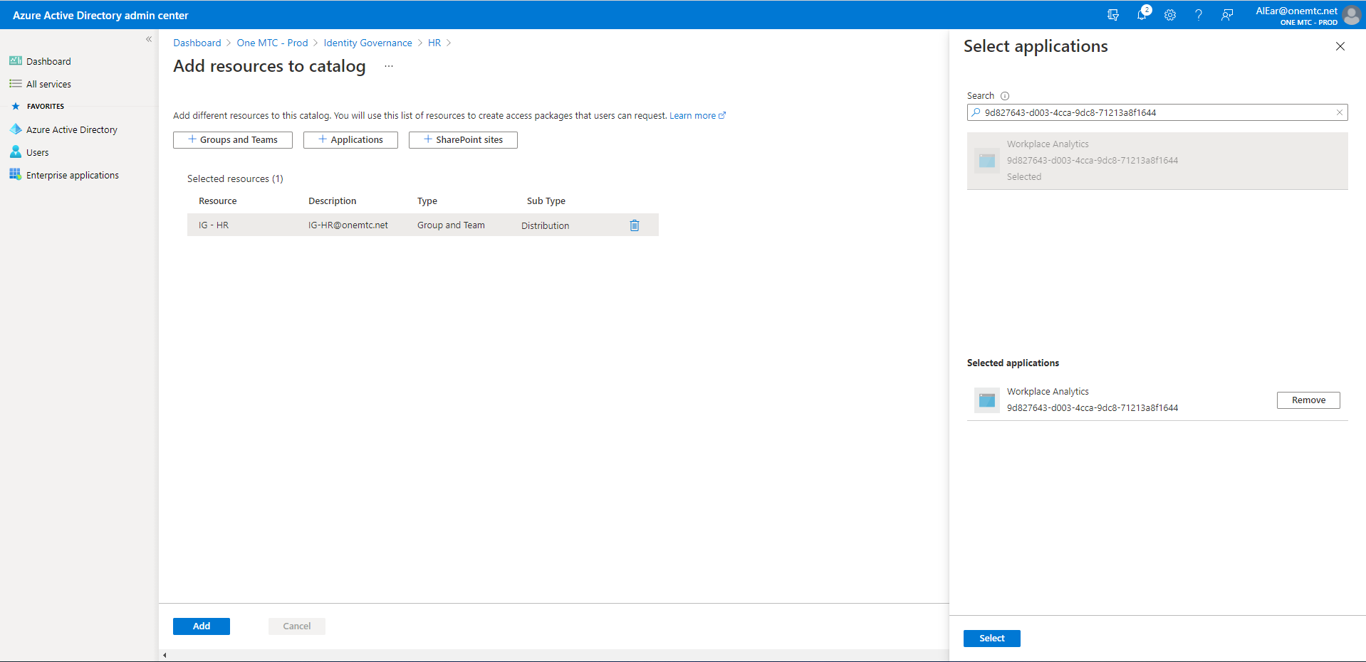
Create Catalog – Step 10

Slide 28
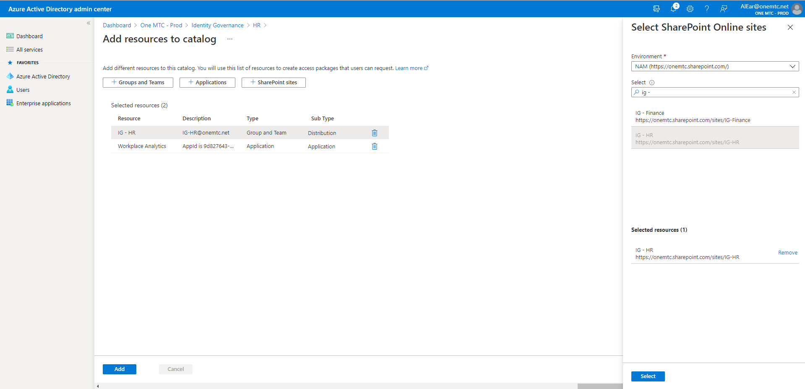
Create Catalog – Step 11

Slide 29
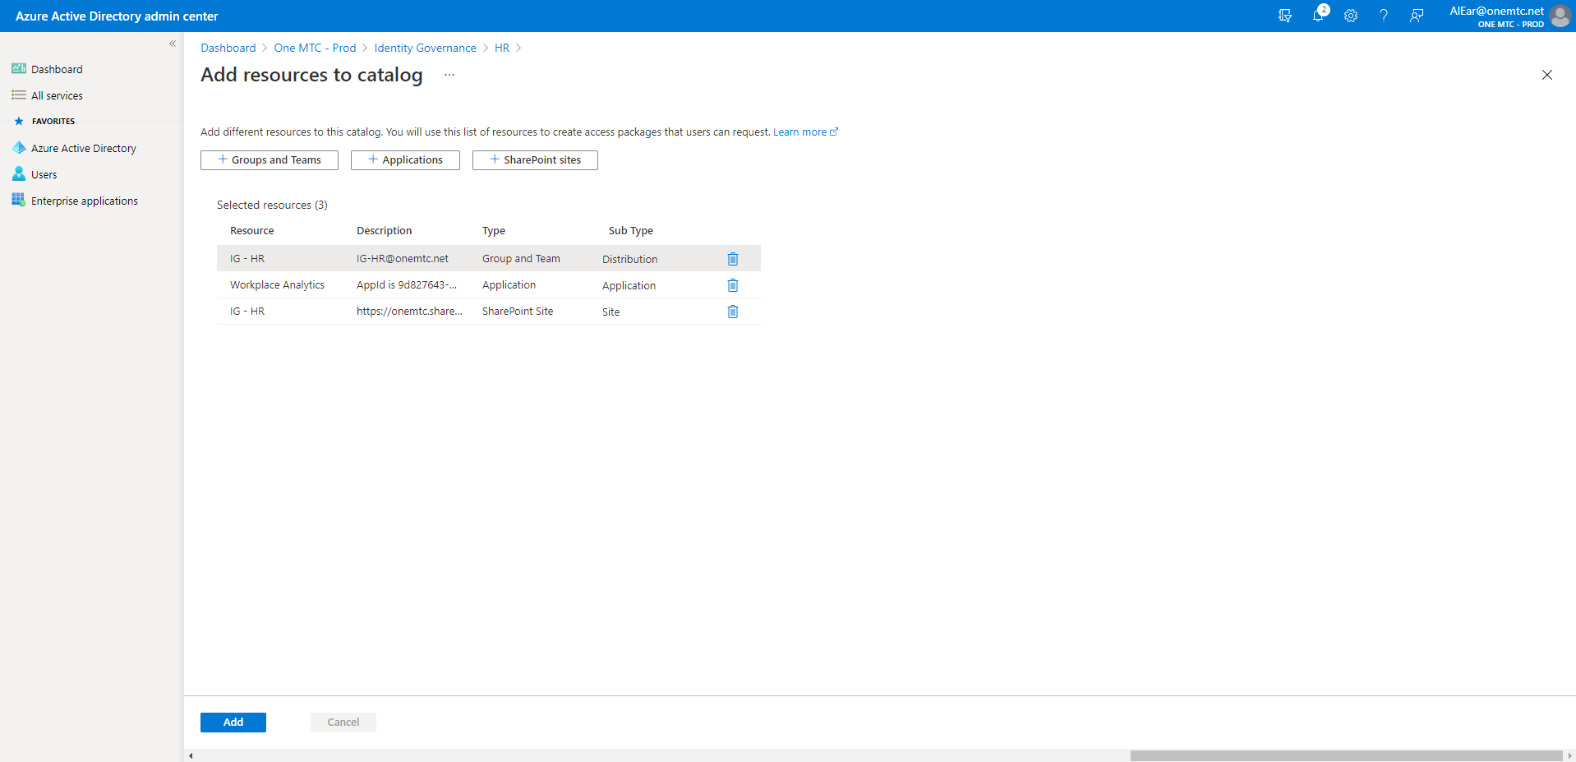
Create Catalog – Step 12

Slide 30
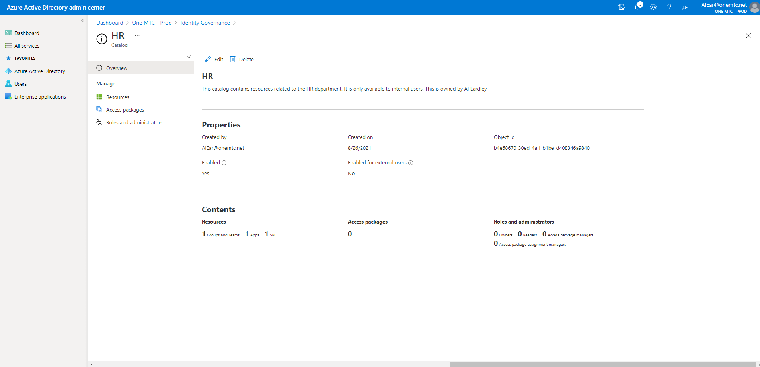
Create Catalog – Step 13

Slide 31
Create Access Package

Slide 32
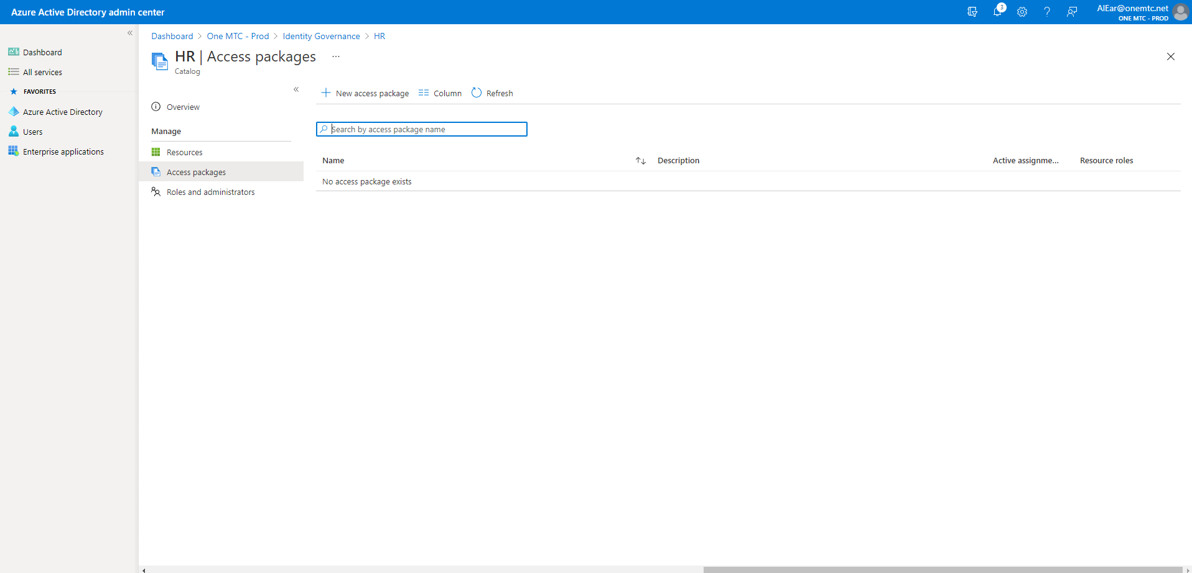
Create an Access Package – Step 1

Slide 33
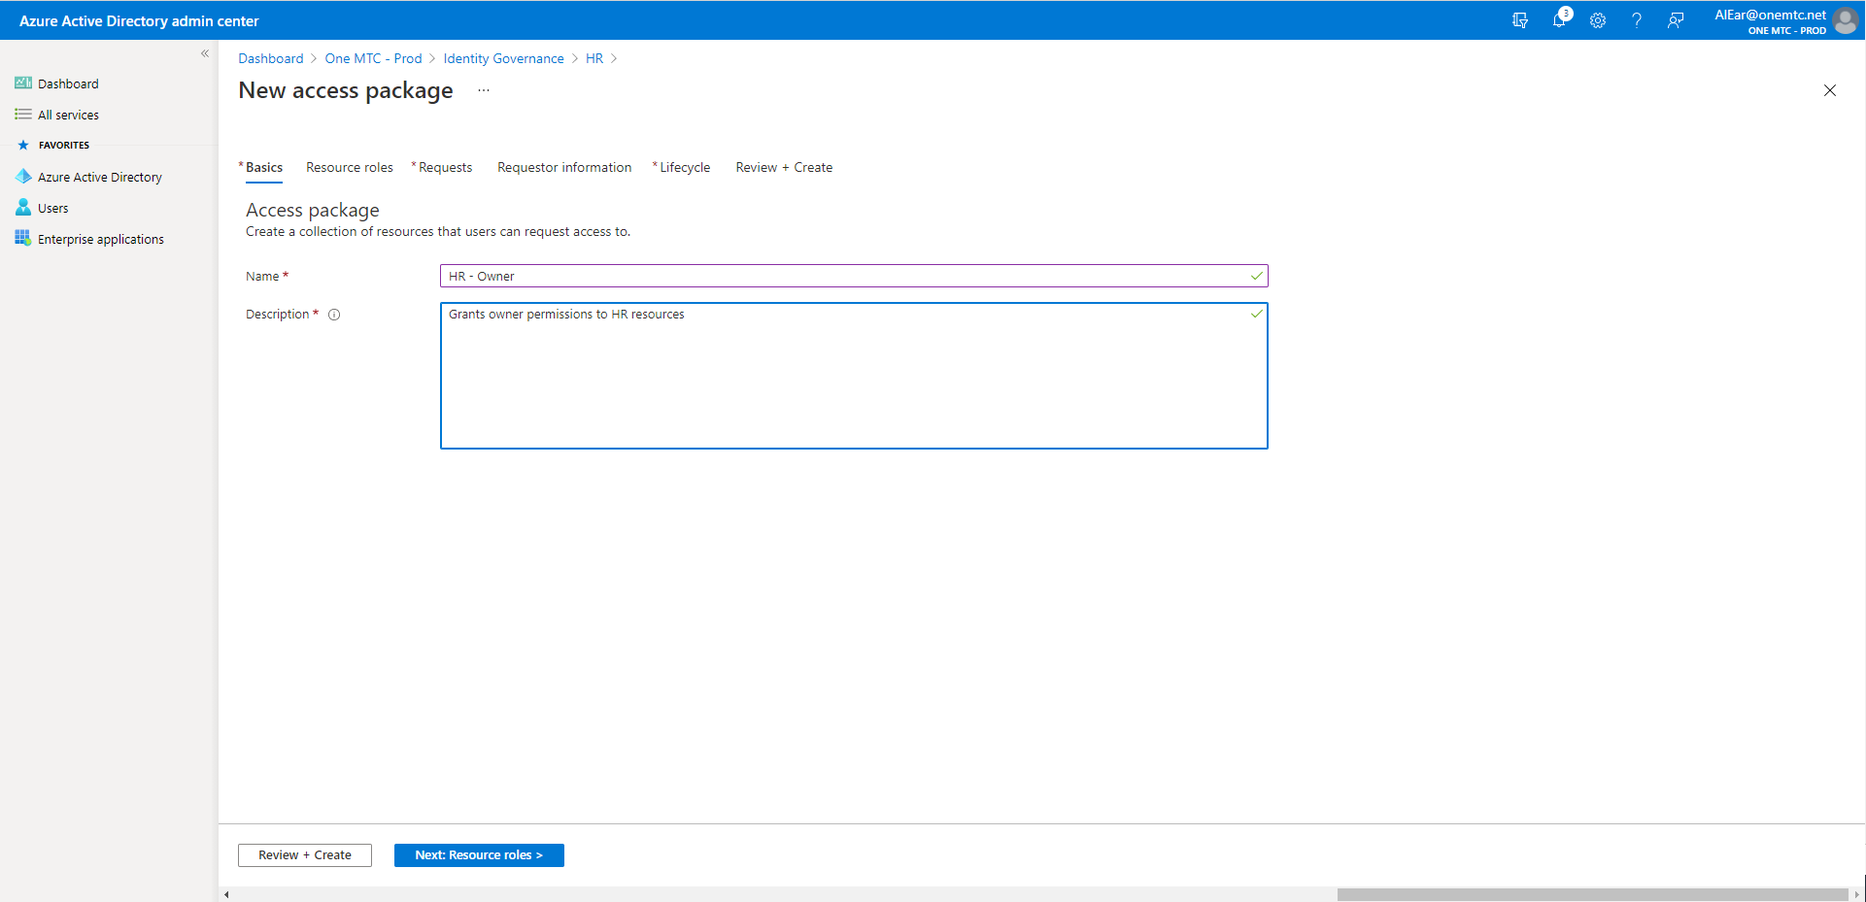
Create an Access Package – Step 2

Slide 34
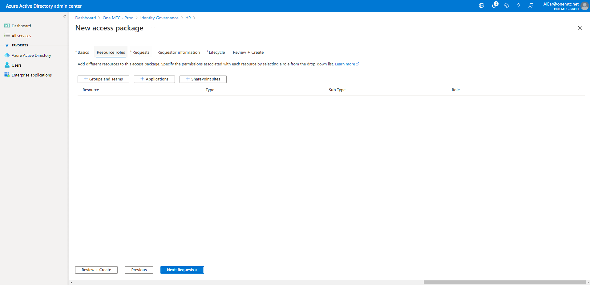
Create an Access Package – Step 3

Slide 35
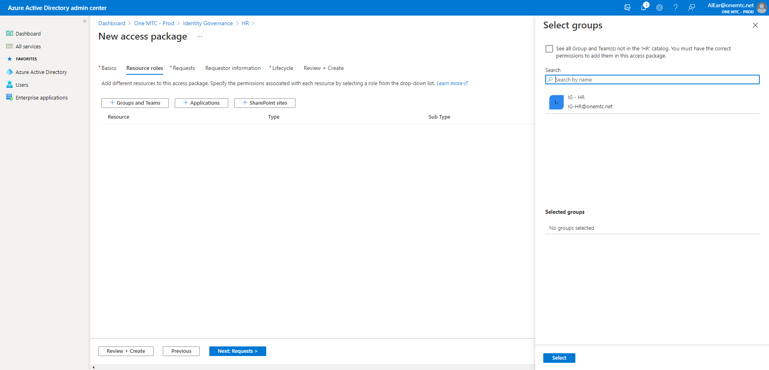
Create an Access Package – Step 4

Slide 36
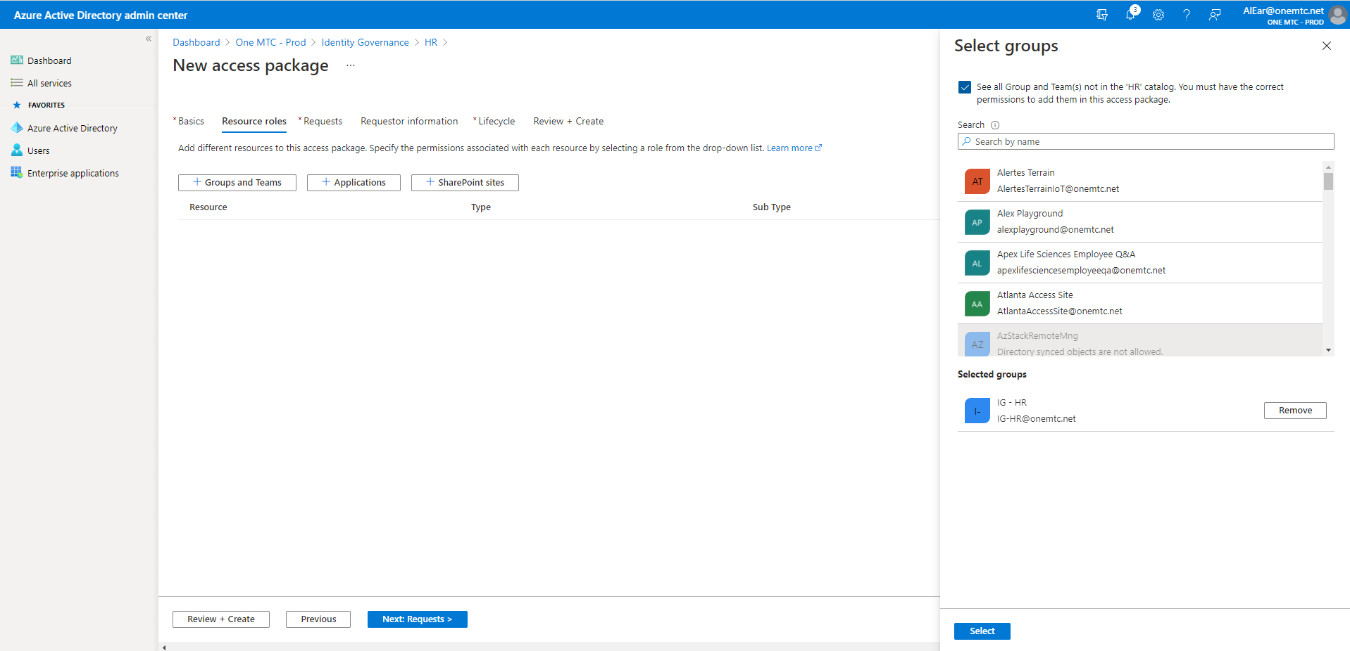
Create an Access Package – Step 5

Slide 37
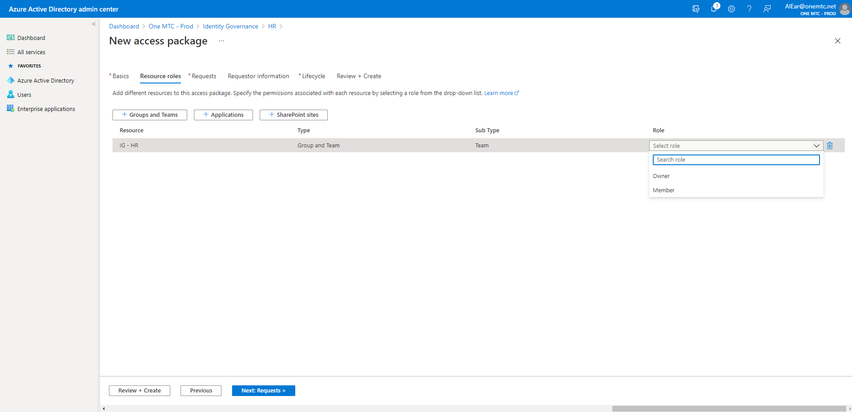
Create an Access Package – Step 6

Slide 38
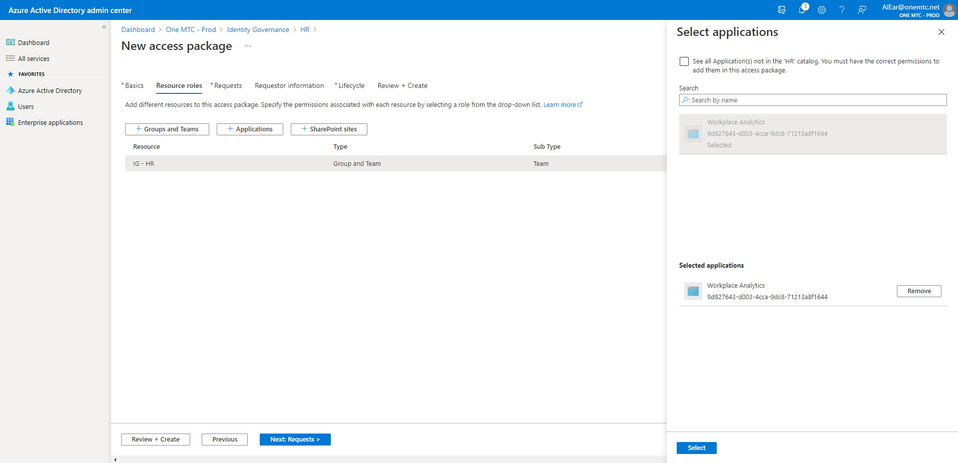
Create an Access Package – Step 7

Slide 39
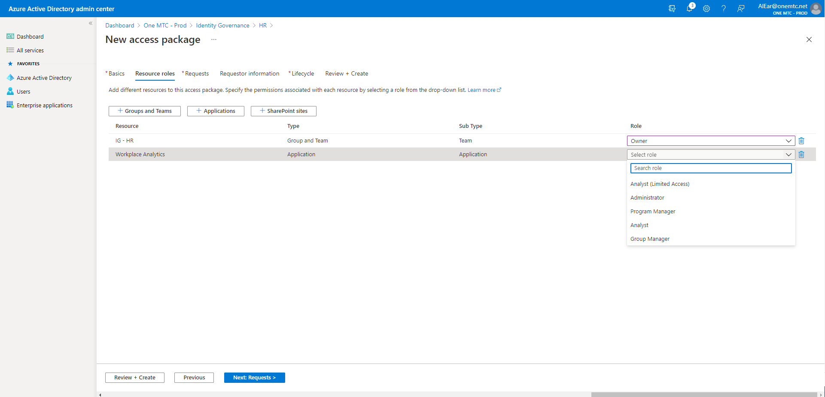
Create an Access Package – Step 8

Slide 40
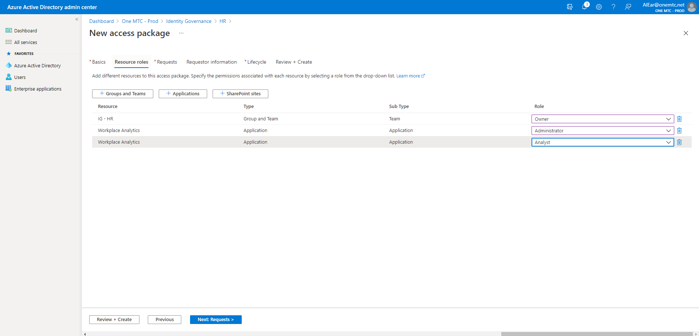
Create an Access Package – Step 9

Slide 41
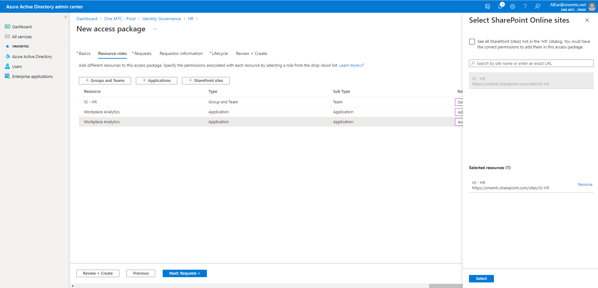
Create an Access Package – Step 10

Slide 42
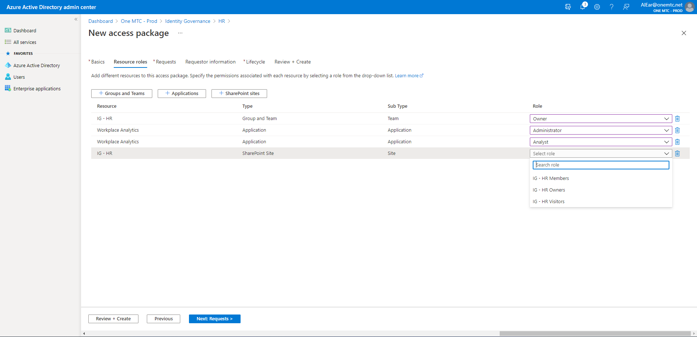
Create an Access Package – Step 11

Slide 43
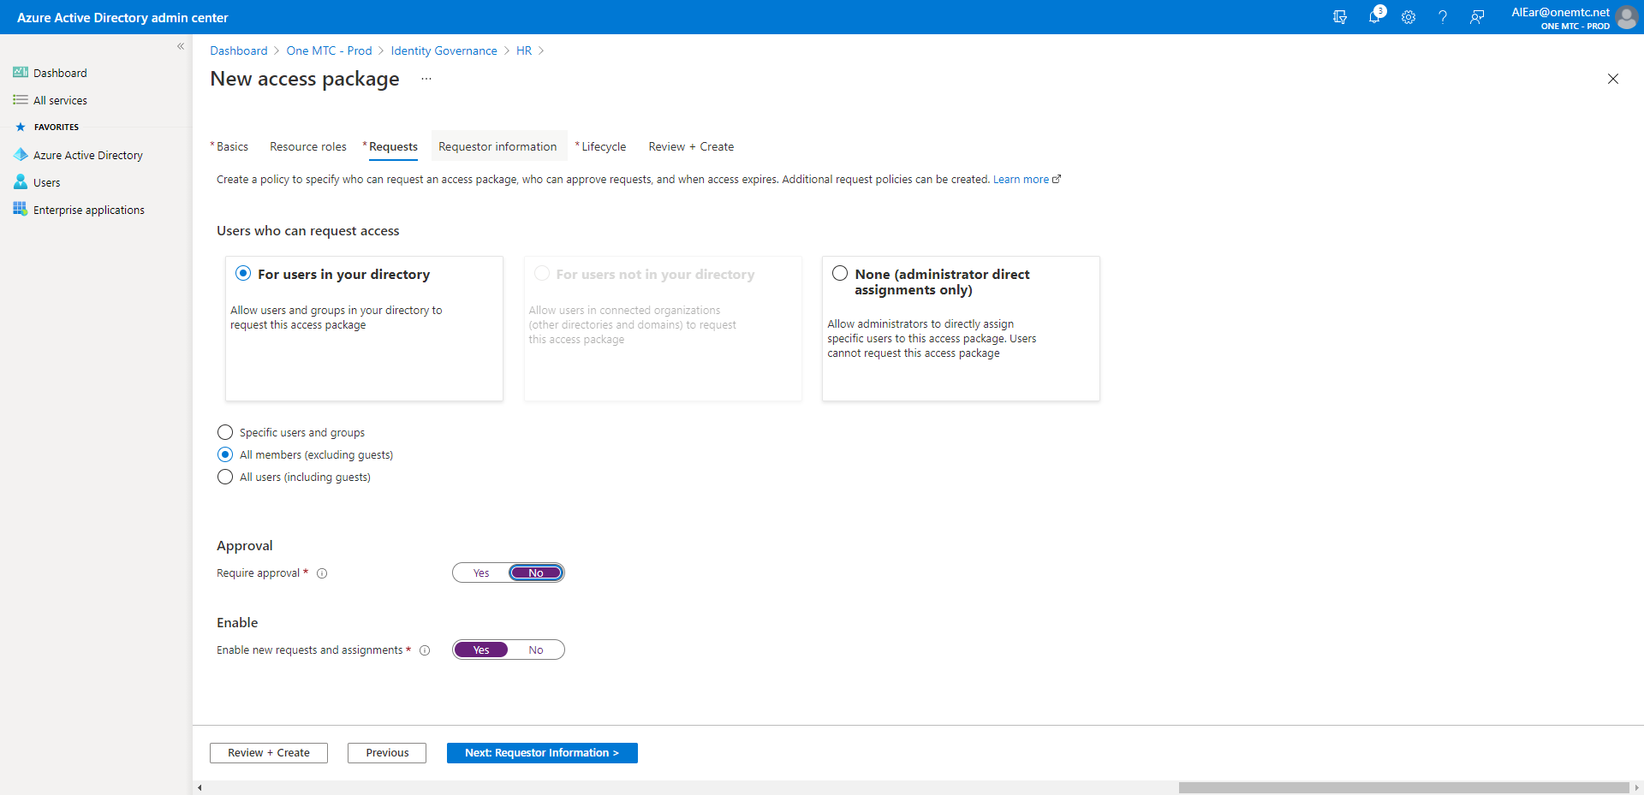
Create an Access Package – Step 12

Slide 44
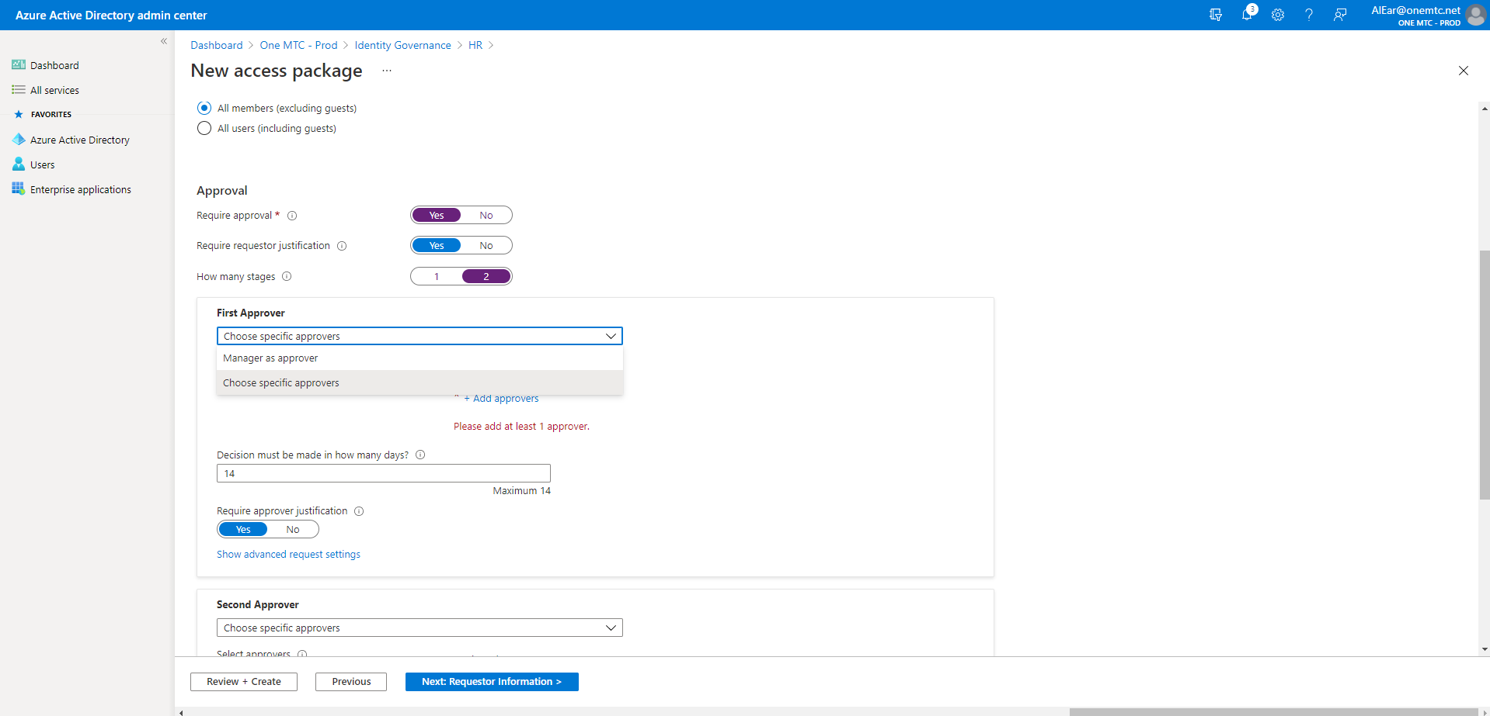
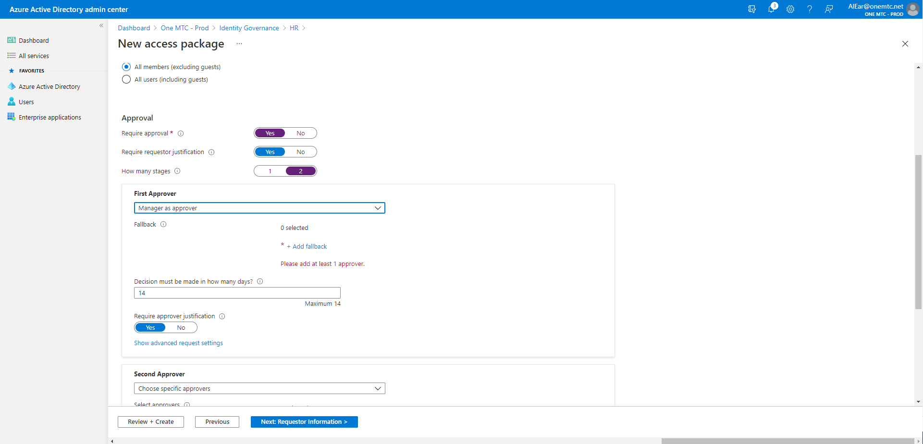
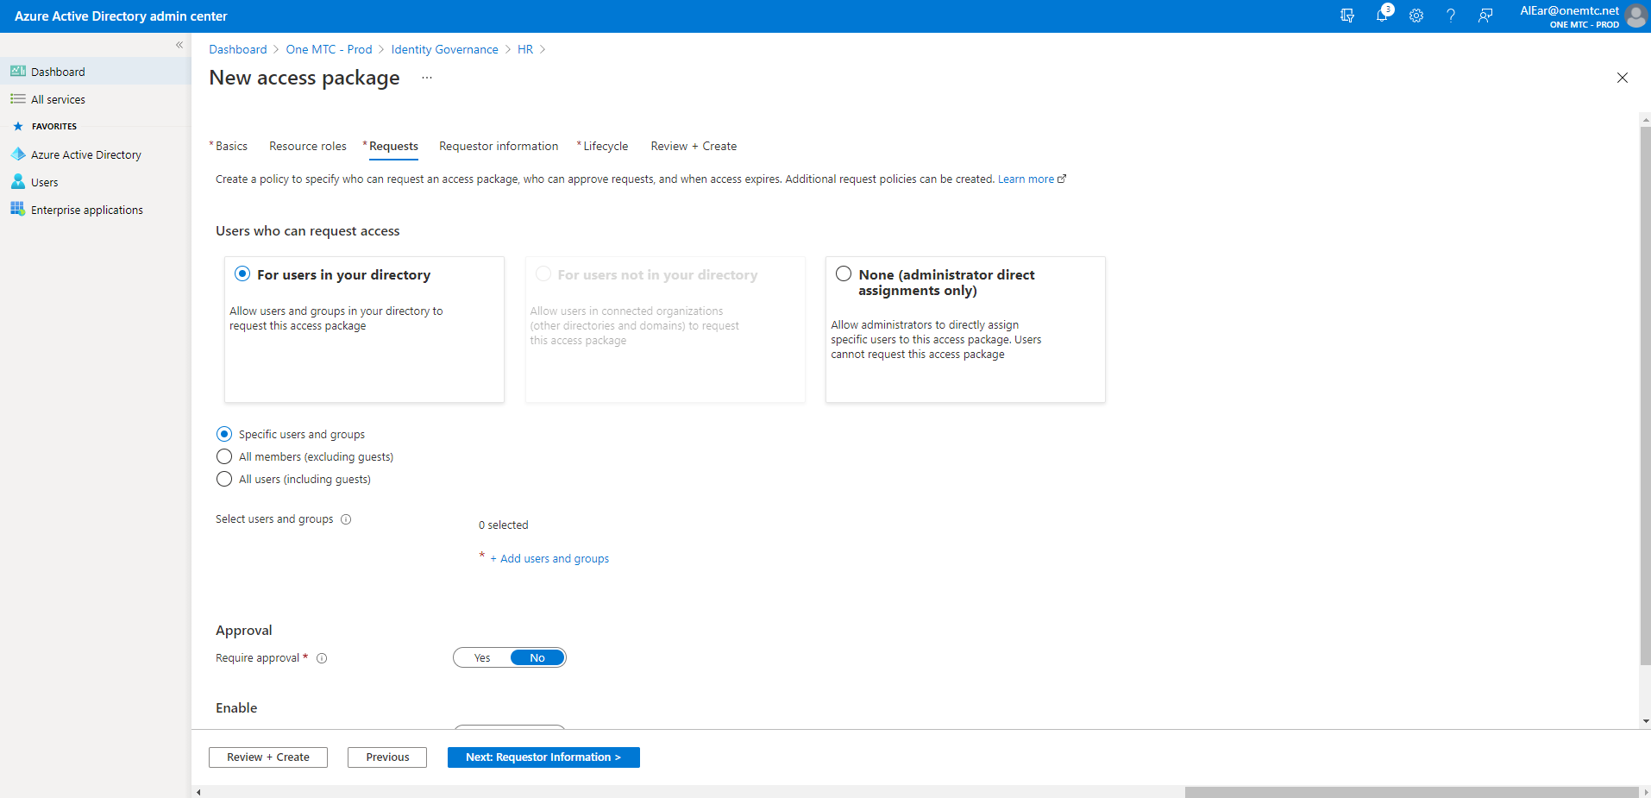
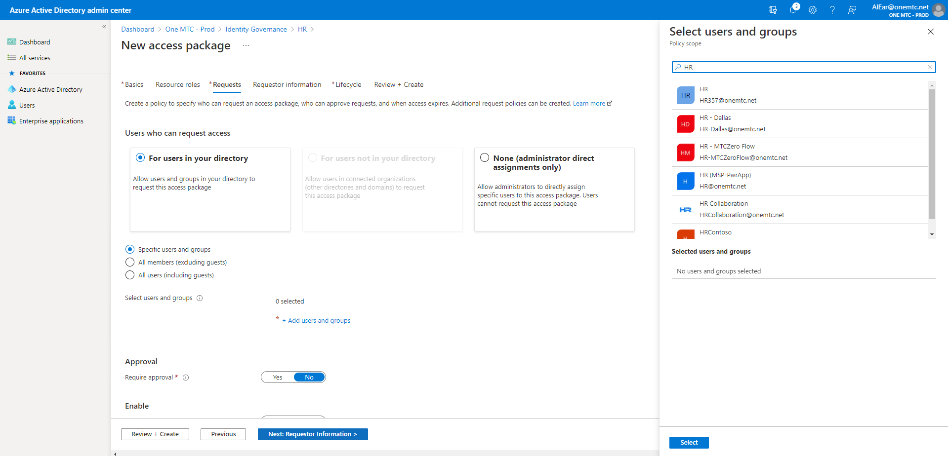
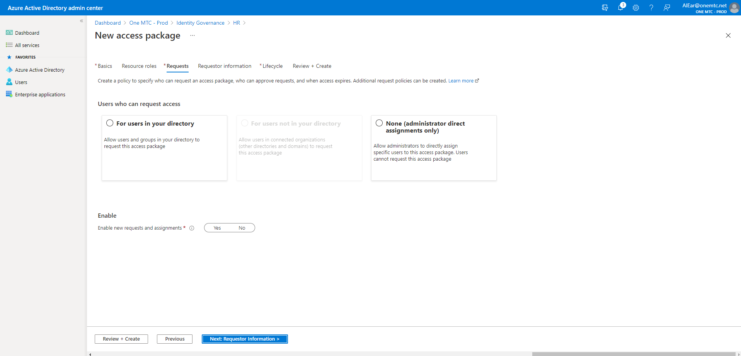
Create an Access Package

Slide 45
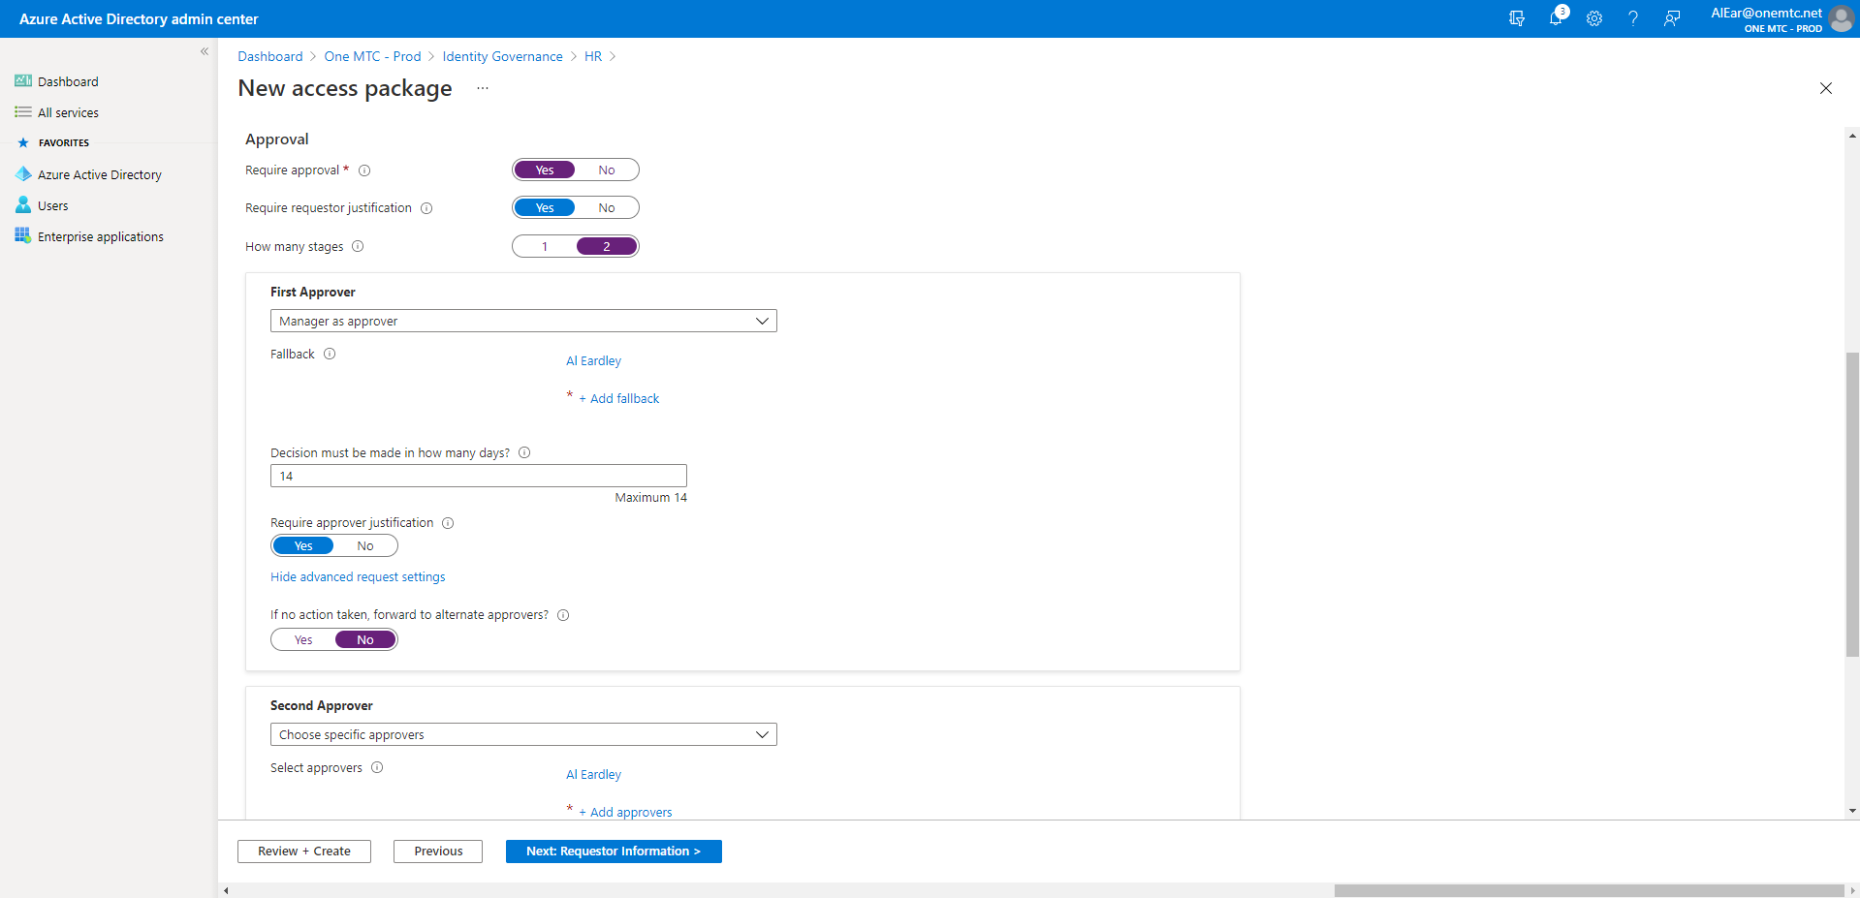
Create an Access Package – Step 13

Slide 46
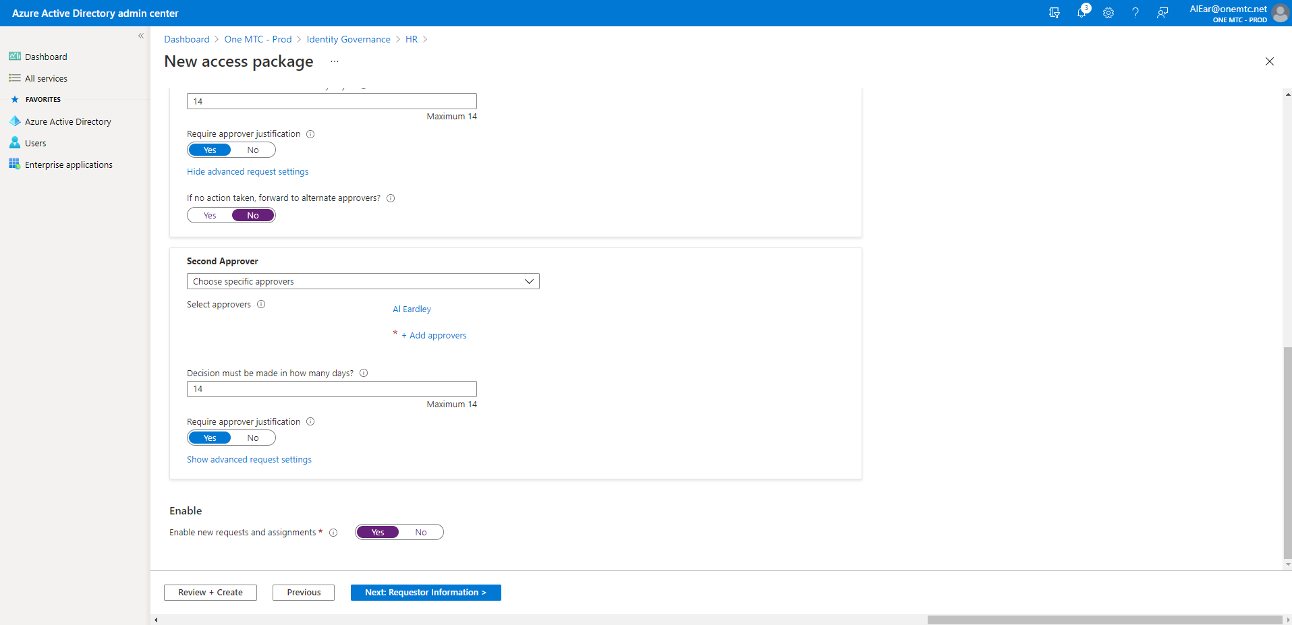
Create an Access Package – Step 14

Slide 47
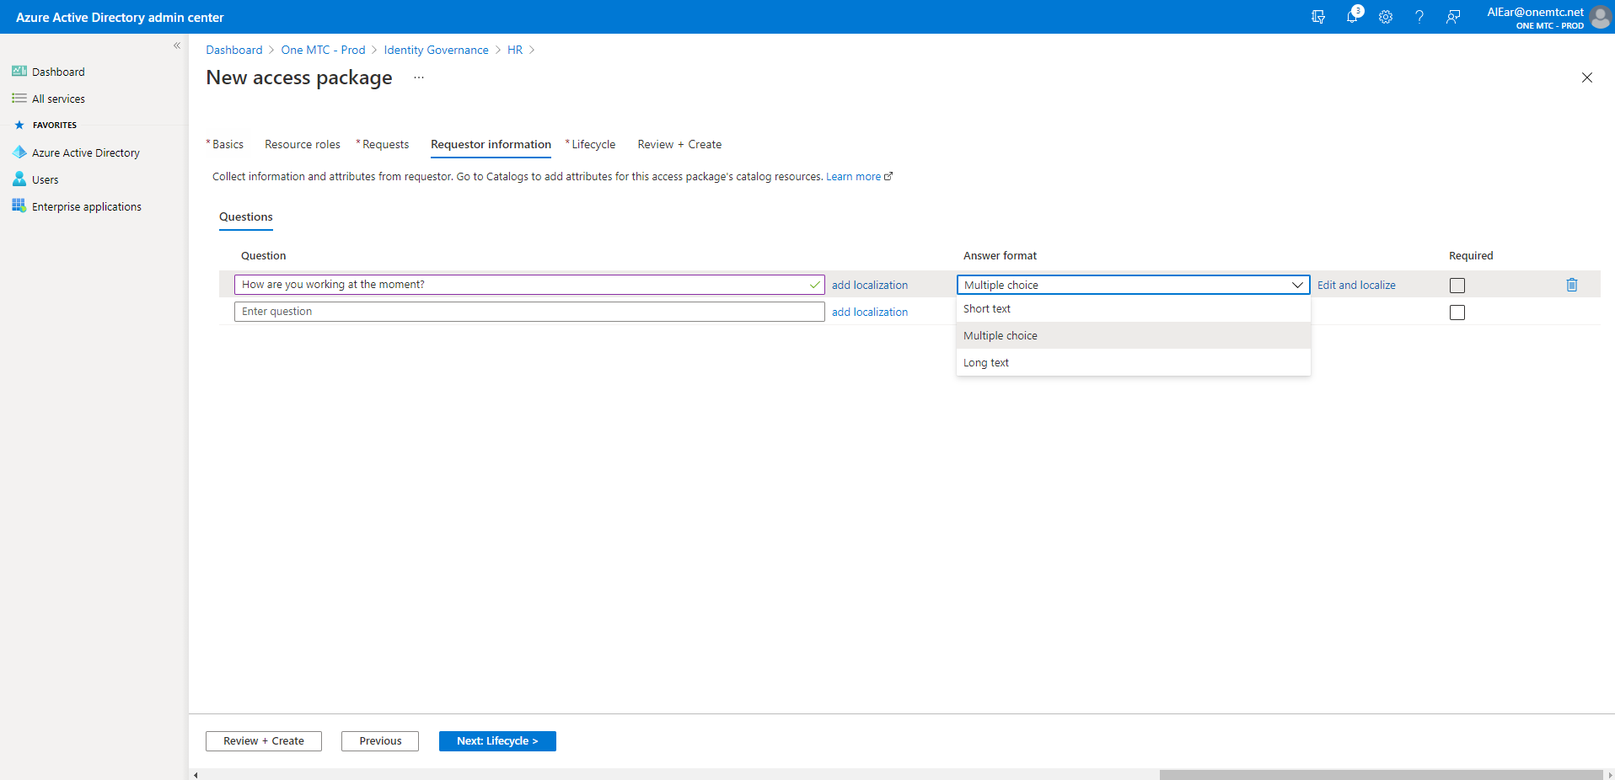
Create an Access Package – Step 15

Slide 48
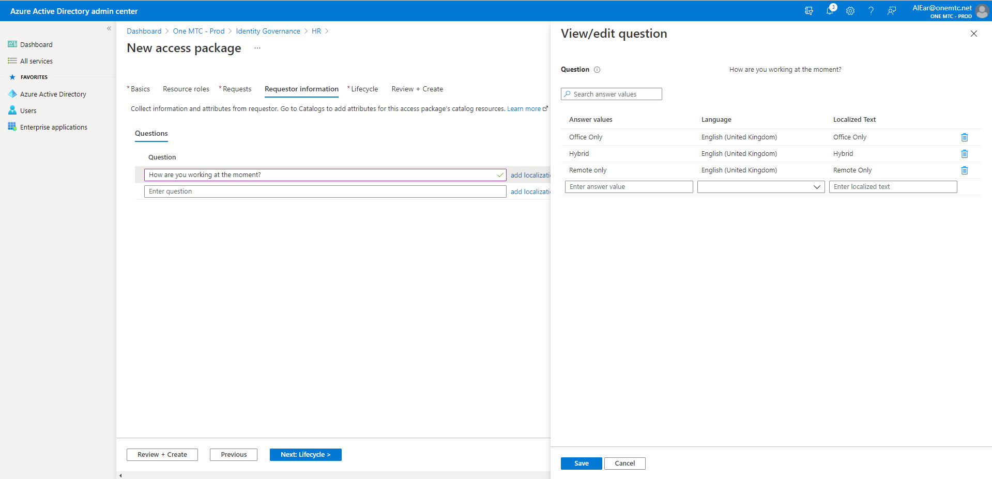
Create an Access Package – Step 16

Slide 49
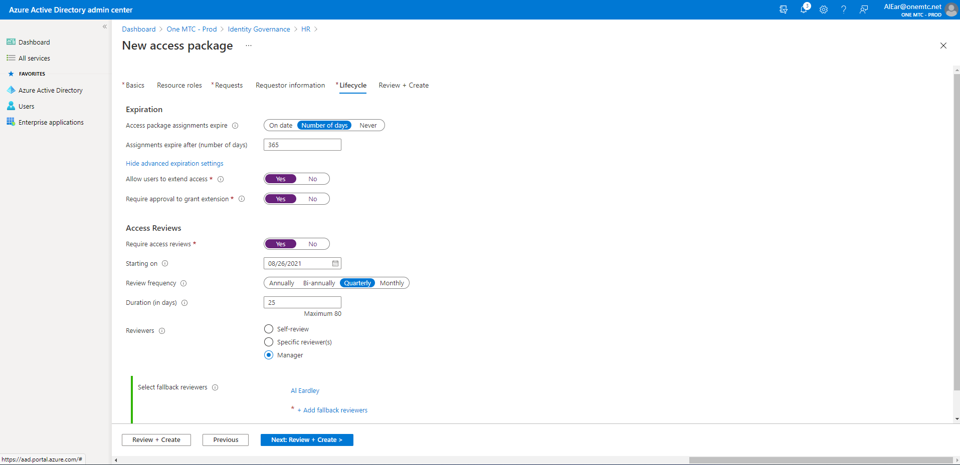
Create an Access Package – Step 17

Slide 50
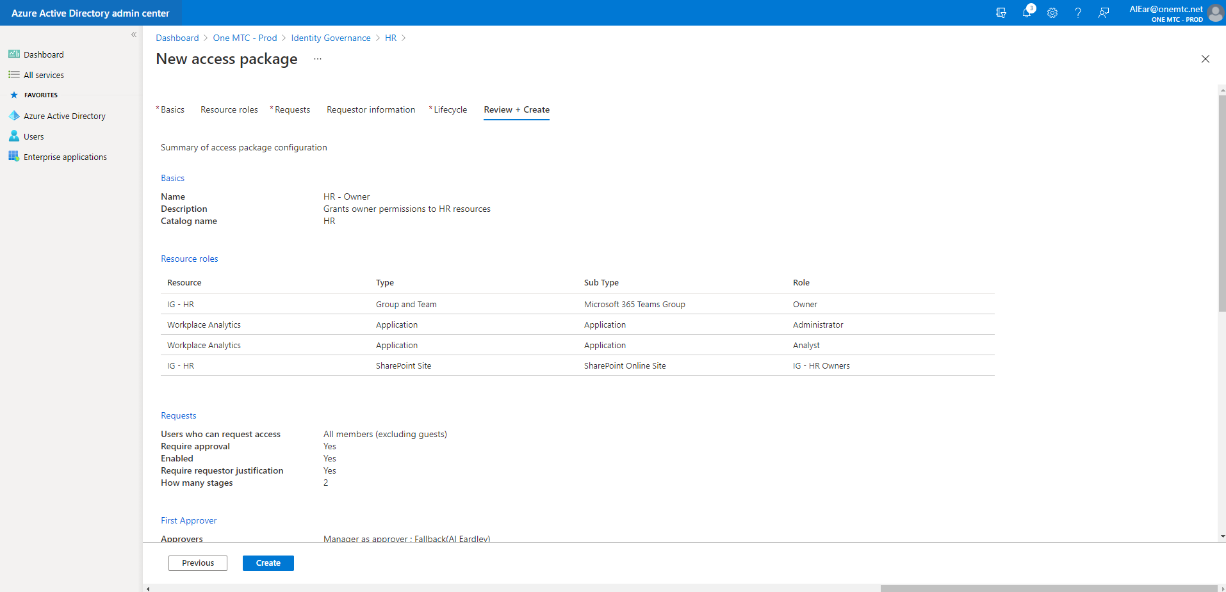
Create an Access Package – Step 18

Slide 51
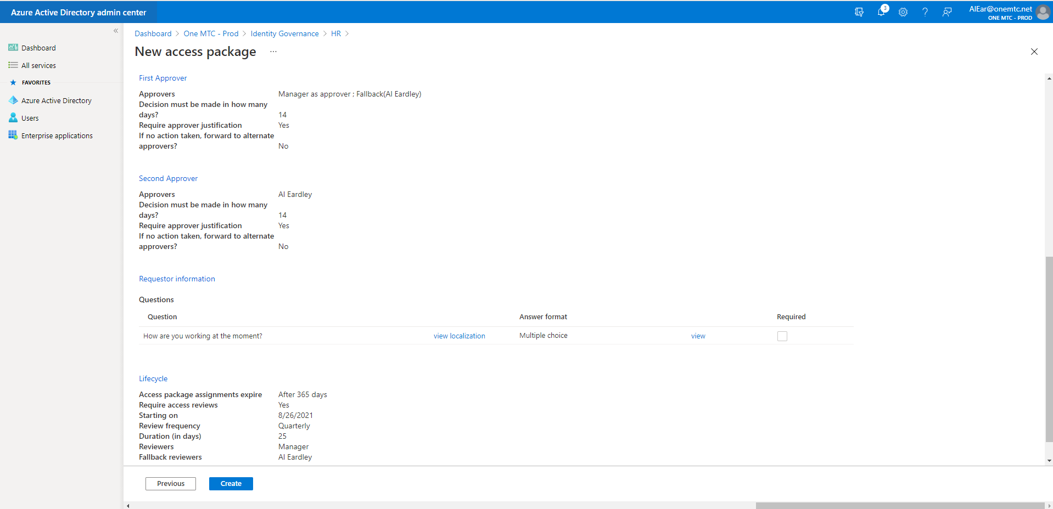
Create an Access Package – Step 19

Slide 52
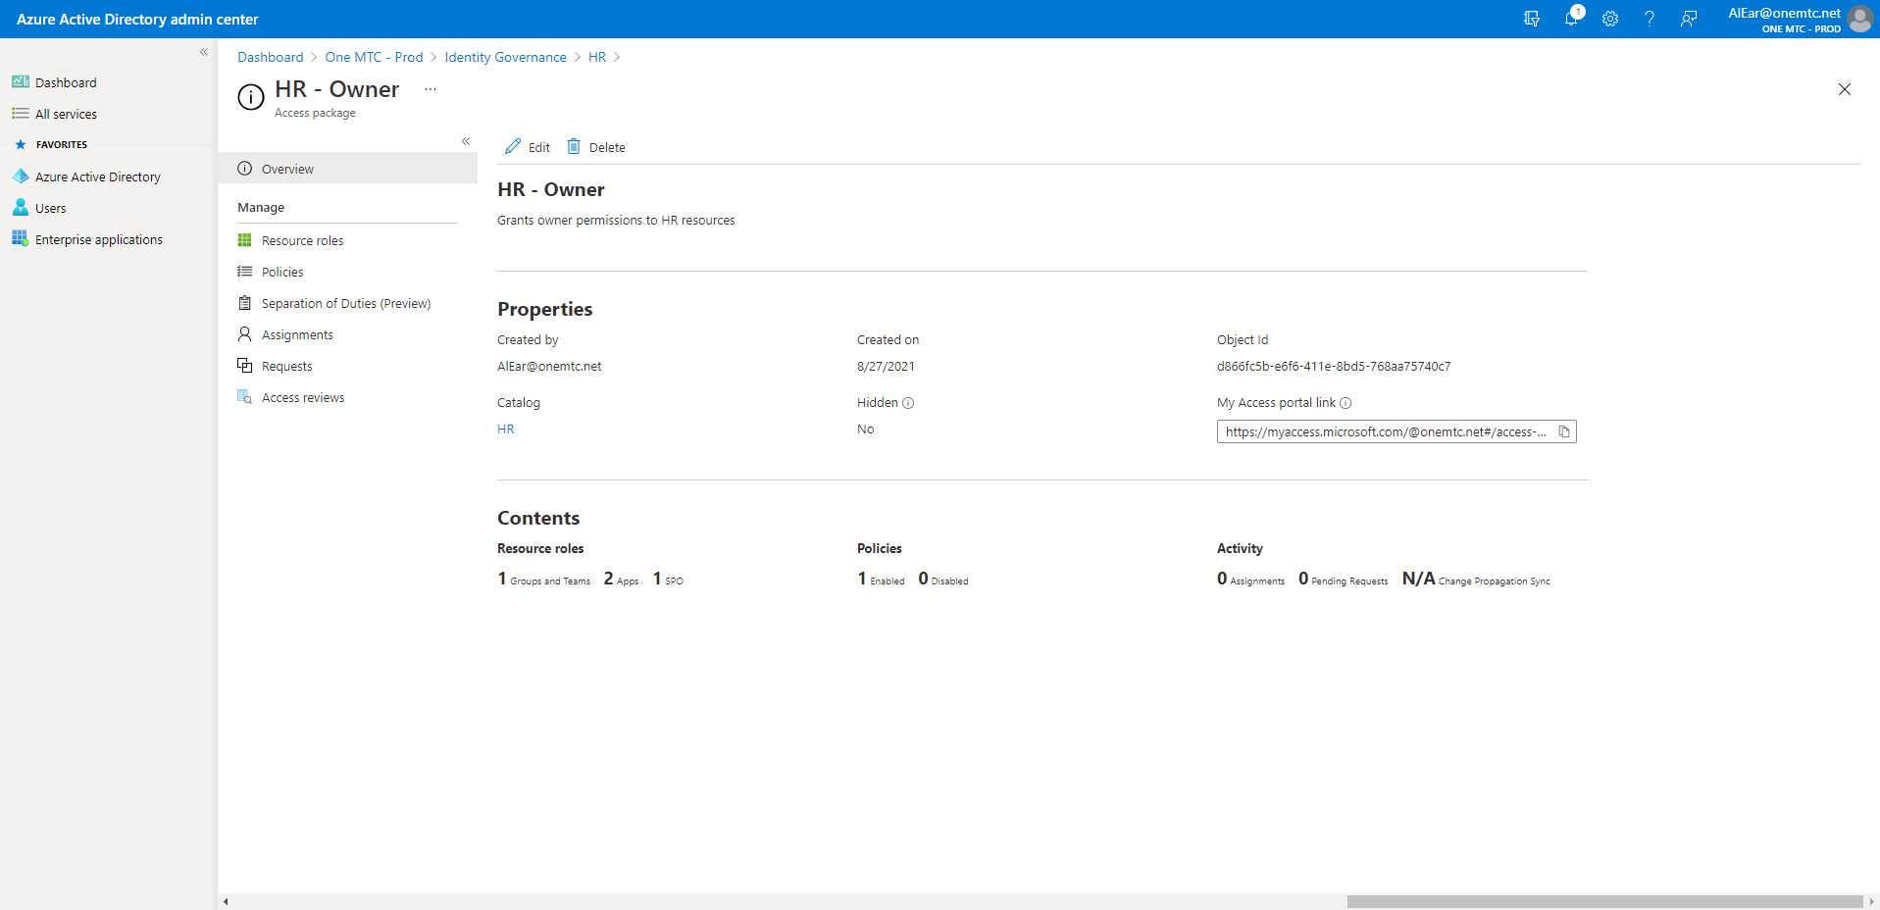
Create an Access Package – Step 20

Slide 53
Create External Access Package

Slide 54
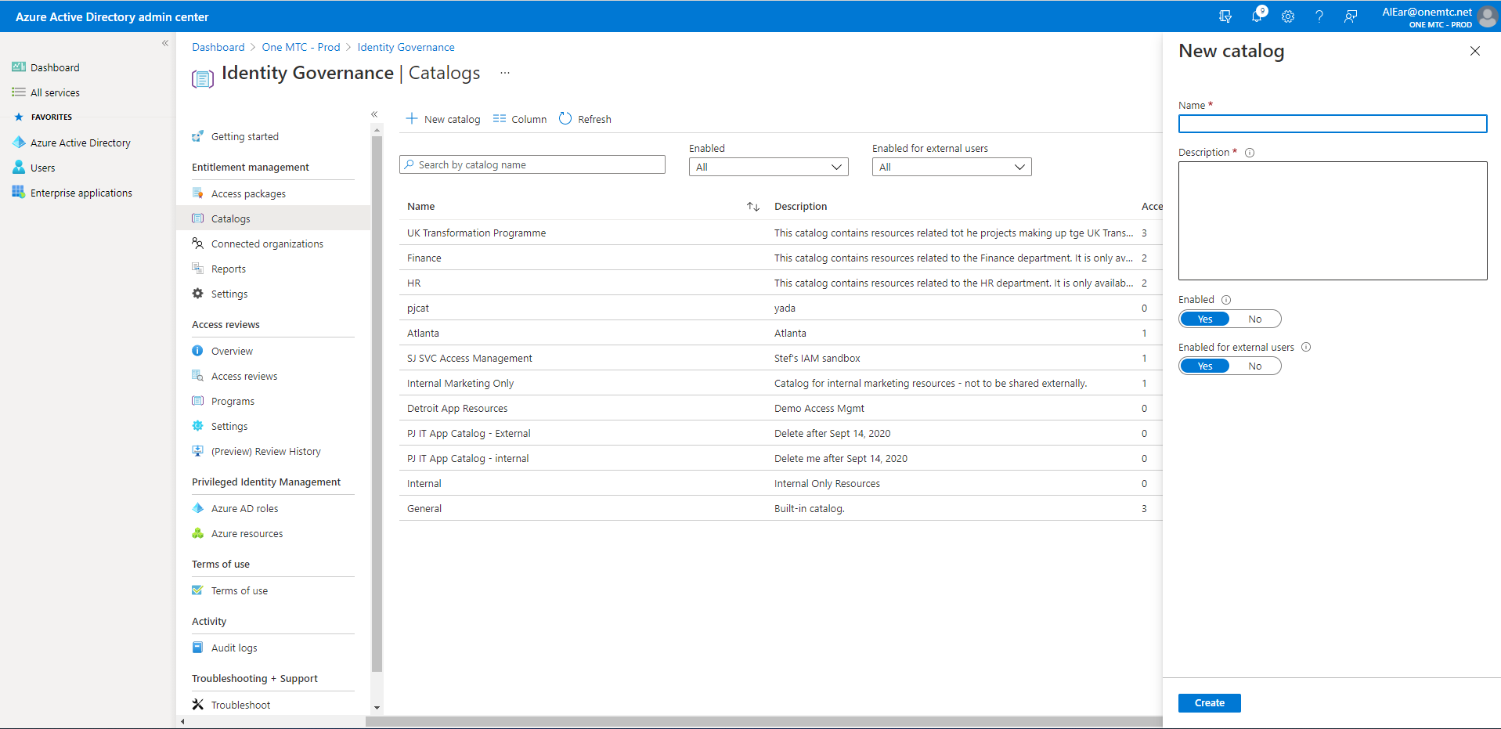

Slide 55
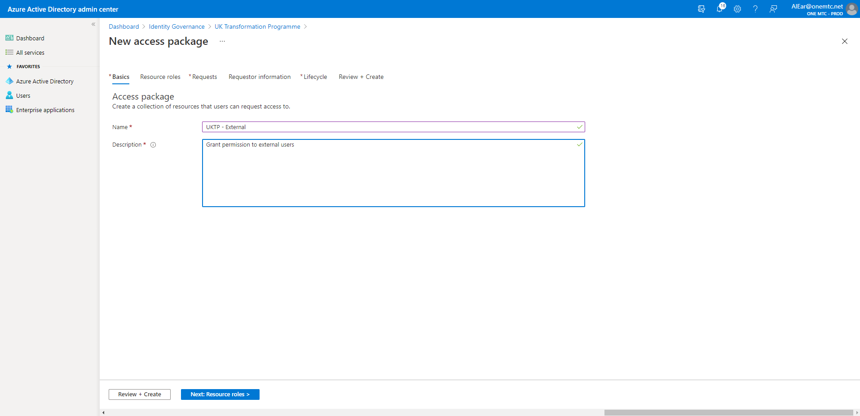
Create External Access Package – Step 1

Slide 56
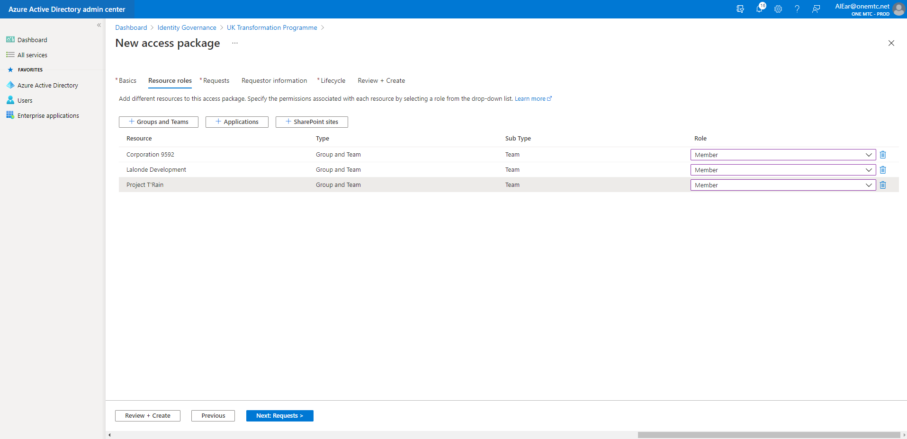
Create External Access Package – Step 2

Slide 57
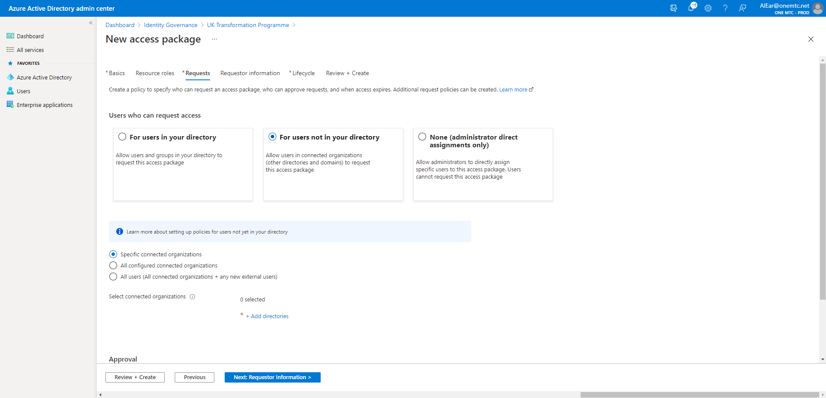
Create External Access Package – Step 3

Slide 58
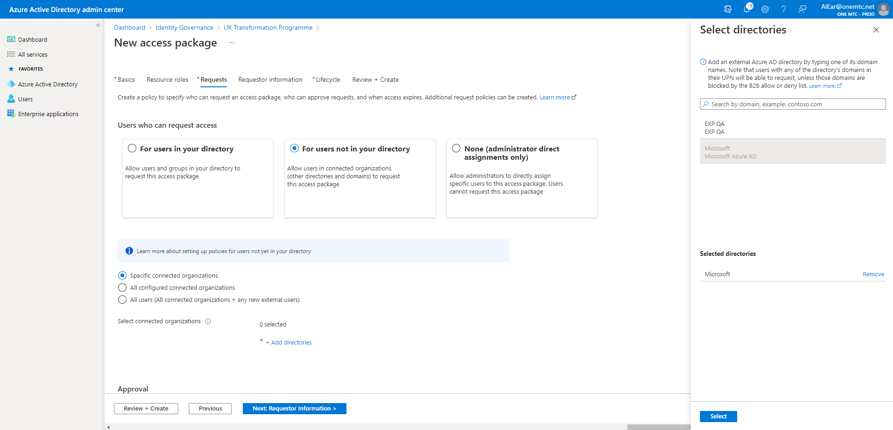
Create External Access Package – Step 4

Slide 59
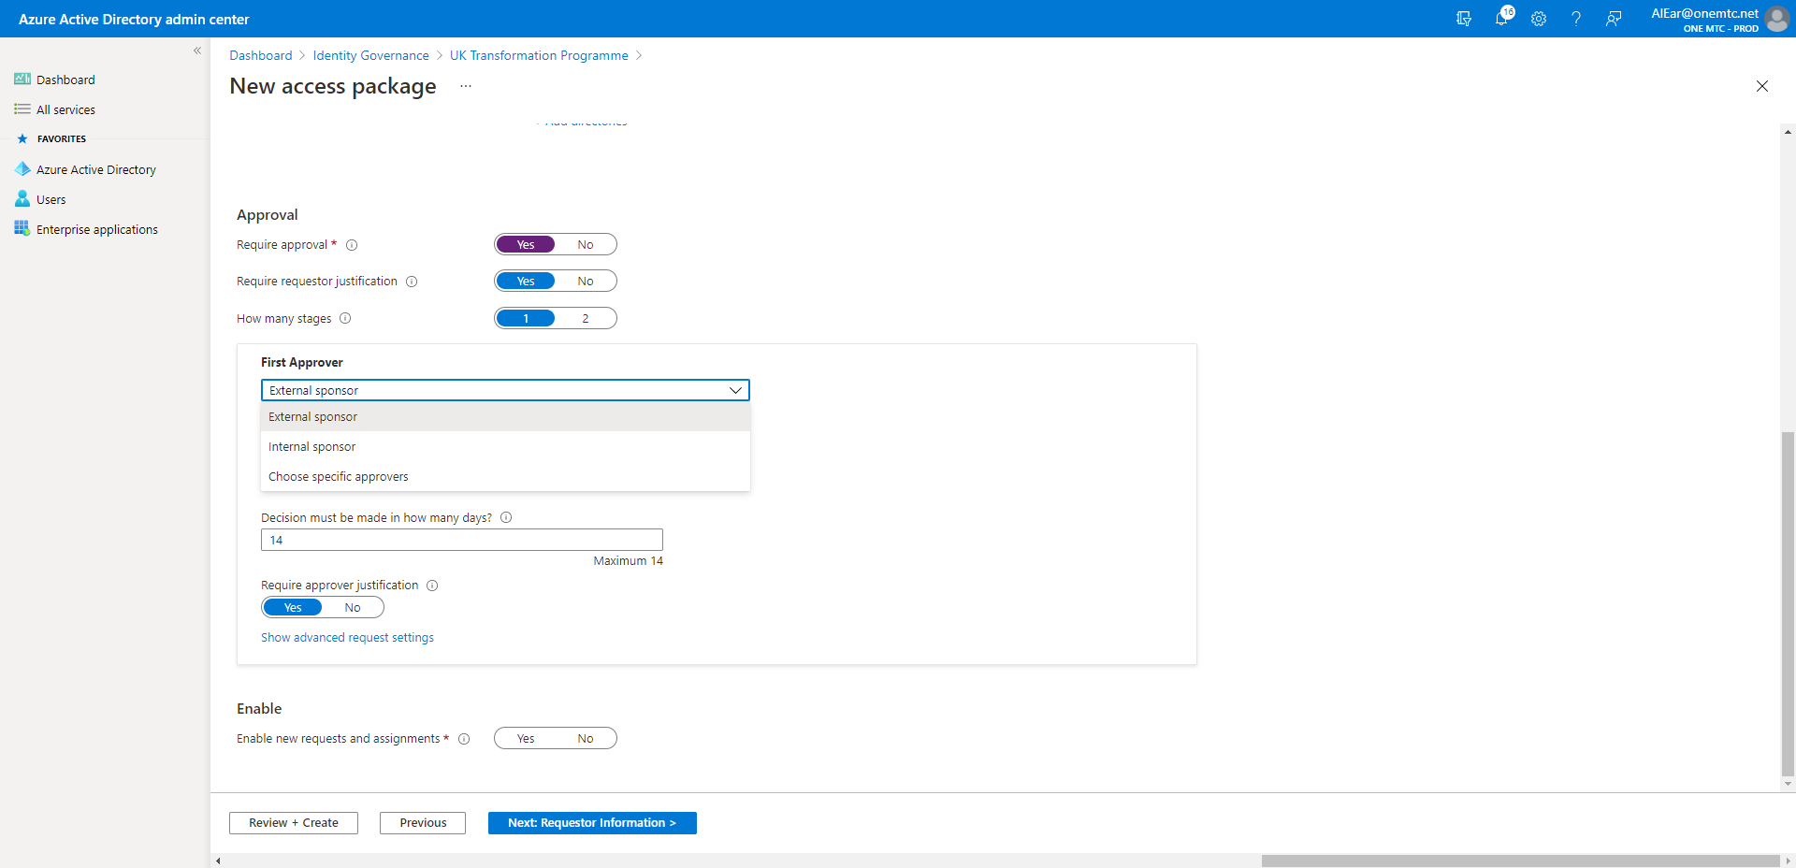
Create External Access Package – Step 5

Slide 60
Request Access

Slide 61
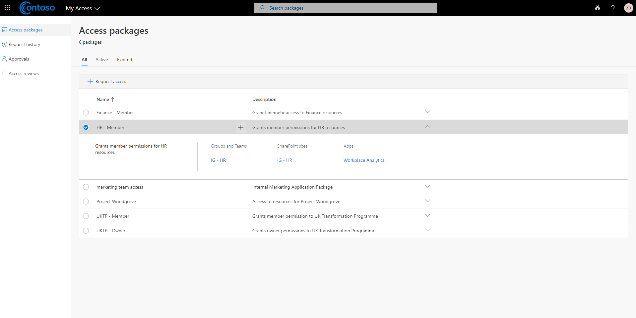
Request Access – Step 1

Slide 62
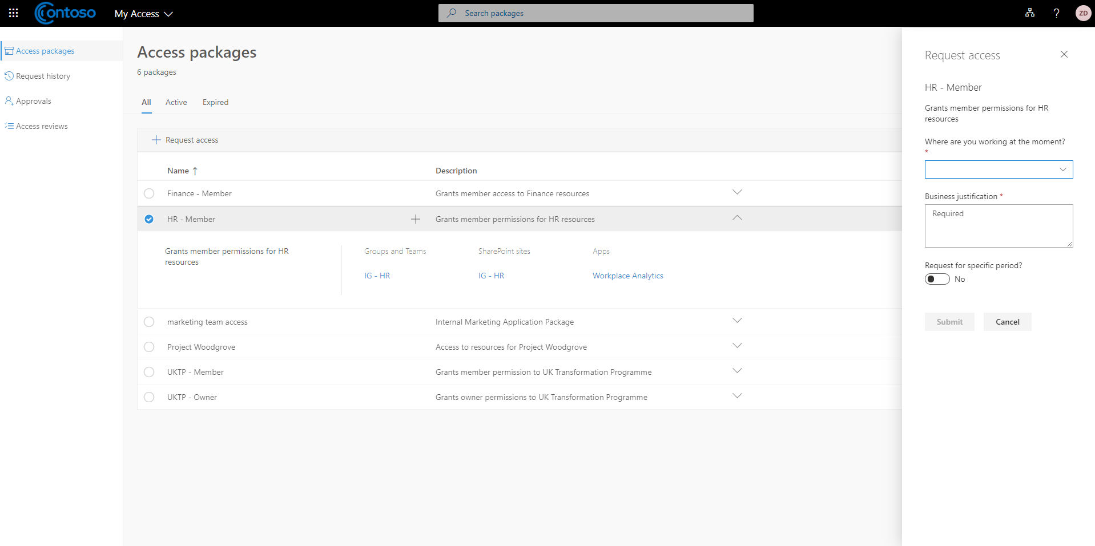
Request Access – Step 2

Slide 63
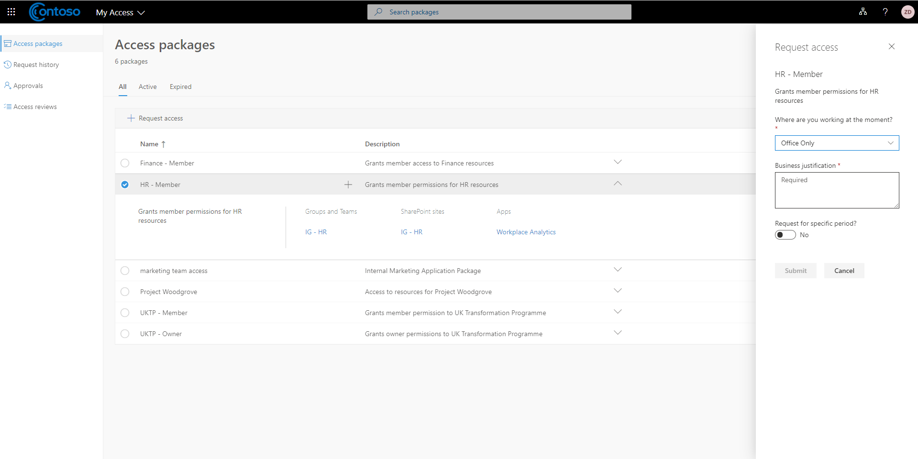
Request Access – Step 3

Slide 64
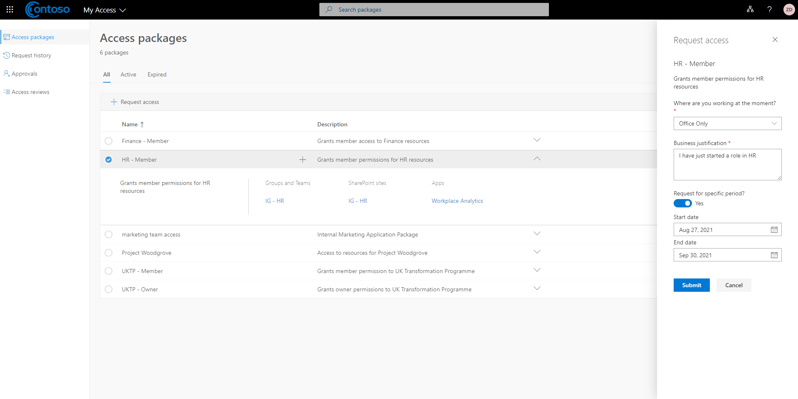
Request Access – Step 4

Slide 65
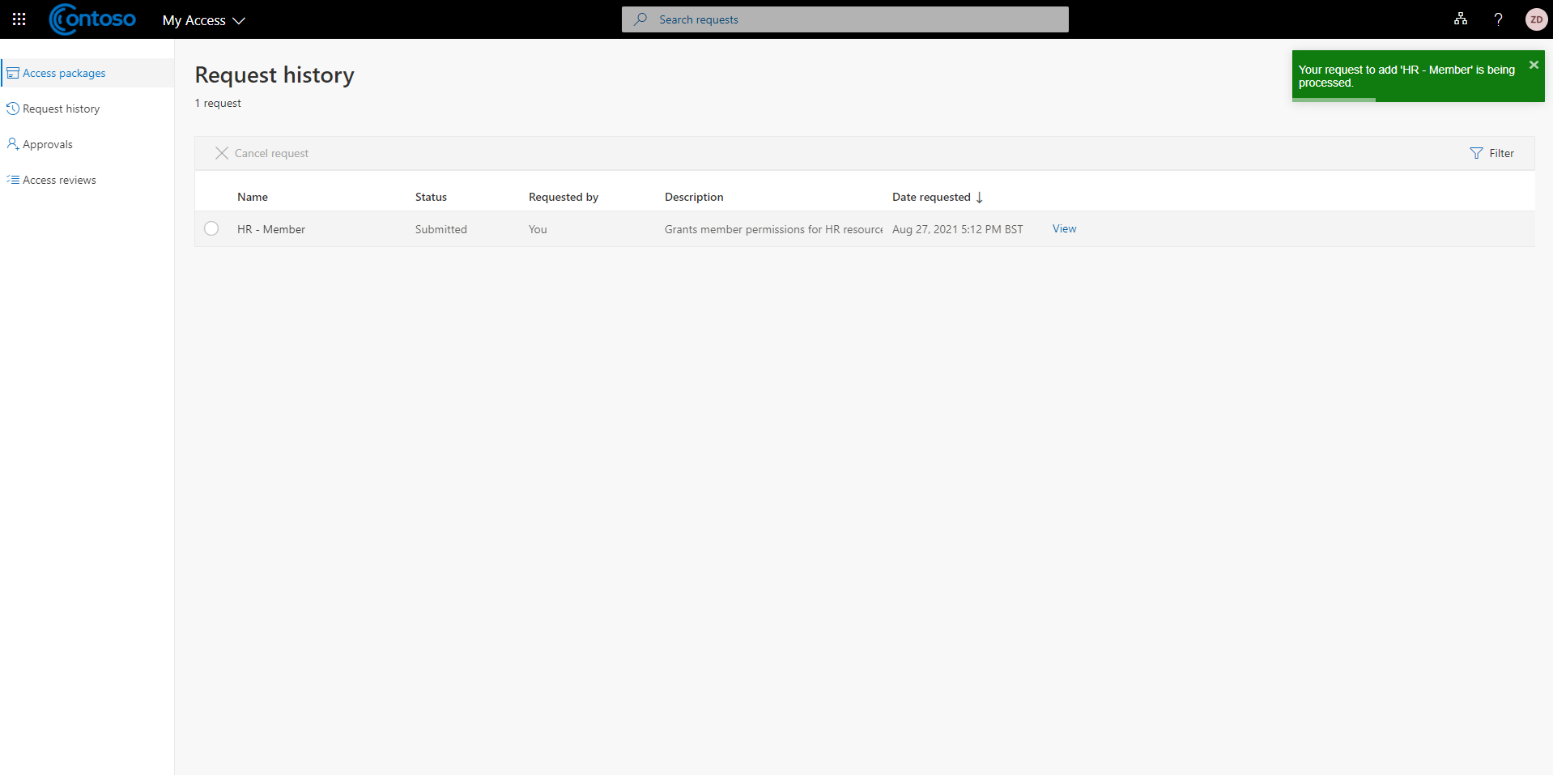
Request Access – Step 5

Slide 66
Request Access – Step 6

Slide 67
Request Access – Step 7

Slide 68
Request Access – Step 8

Slide 69
Request Access – Step 9

Slide 70
Request Access – Step 10

Slide 71
Request Access – Step 11

Slide 72
Request Access – Step 12

Slide 73
Request Access – Step 13

Slide 75
Request Access – Step 14

Slide 76
Request Access – Step 15

Slide 77
Request Access – Step 16

Slide 78
Separation of Duties

Slide 81
Request Access – Step 21

Slide 82
Configuration and Auditing

Slide 83
Identity Governance Settings

Slide 84
Audit Logging

Slide 85
The benefits

Slide 86
Licencing
Entitlements requires Azure AD Premium P2
Member users who CAN request an access package
Member and guest users who request an access package
Members and guests who approve an access package
Members and guests who are directly assigned to an access package
Notes:
Al
A Global Administrator at Woodgrove Bank creates initial catalogs and delegates administrative tasks to 6 other users. One of the policies specifies that All employees (2,000 employees) can request a specific set of access packages. 150 employees request the access packages.
2,000 employees who can request the access packages
2,000
A Global Administrator at Woodgrove Bank creates initial catalogs and delegates administrative tasks to 6 other users. One of the policies specifies that All employees (2,000 employees) can request a specific set of access packages. Another policy specifies that some users from Users from partner Contoso (guests) can request the same access packages subject to approval. Contoso has 30,000 users. 150 employees request the access packages and 10,500 users from Contoso request access.
2,000 employees + 500 guest users from Contoso that exceed the 1:5 ratio (10,500 - (2,000 * 5))
2,500

Slide 87
Reduced effort with more control
Group permissions based on role
Self-service request
Full lifecycle management
Delegate approval to external sponsors

Slide 88
The future

Slide 89
Microsoft Acquires CloudKnox Security
Extend capabilities
Include external clouds
Cloud Infrastructure Entitlement Management (CIEM)

Slide 90
Key Concepts
As an Admin
Create a Catalog
As a user
Browse Access Packages
Request Access Package
As a Manager
Approve Access Package
As a User
Get Access
As a Manager
Review Access
Create access packages

Slide 91
Questions
Notes:
Can you see this approach and these tools helping you?
What are the blockers that you can see in using To Do and Planner?

Slide 92
Thanks to all the sponsors

Slide 93
CyberSec and Microsoft 365 in action
Session Code:
31412

Slide 94
Thank-you Al Eardley Twitter: @al_eardley LinkedIn: /alaneardley
Prizes for submitting session reviews:
https://forms.office.com/r/numyHDyk8y
Session Code:
14613

